Slide 1

EYEBROW · ALL CAPS
Headline goes here.
Two or three lines.
One colour, never Sky Blue.
Supporting copy. Say what the reader gets and why it matters.
SERIES OR COLUMN NAME
by Author name
Notes:
CAROUSEL CARD 1 of 13 · 1080 x 1350 · LinkedIn portrait.
WHAT TO CHANGE — the copy only. Type into the boxes. Every box already carries the right face, weight, size and tracking; restyling them is how a carousel stops looking like the others in the set.
THE HEADLINE is Neuzeit Grotesk Black, one colour, never Sky Blue (§7.7a). The accent lives in the eyebrow, a rule, or a single stat instead.
ILLUSTRATIONS are placed as pictures and were left untouched by the templatiser. Swap one with right-click → Change Picture, or delete it and let the card breathe. Build new ones with the cubewise-illustration skill so they inherit the same palette and guards.
THE CUBEWISE LOGO is canonical (§8). Do not recolour, stretch or replace it. Card 1 and card N carry it; the middle cards do not (§11.2).
SOCIAL IS SKY BLUE (§11.0) whatever the subject. Max 10 cards. Card N carries a real call to action, not a sign-off.
BACKGROUNDS group in twos to fours before switching (§7.4a). A card-by-card alternation reads as a strobe, not a rhythm.

Slide 2
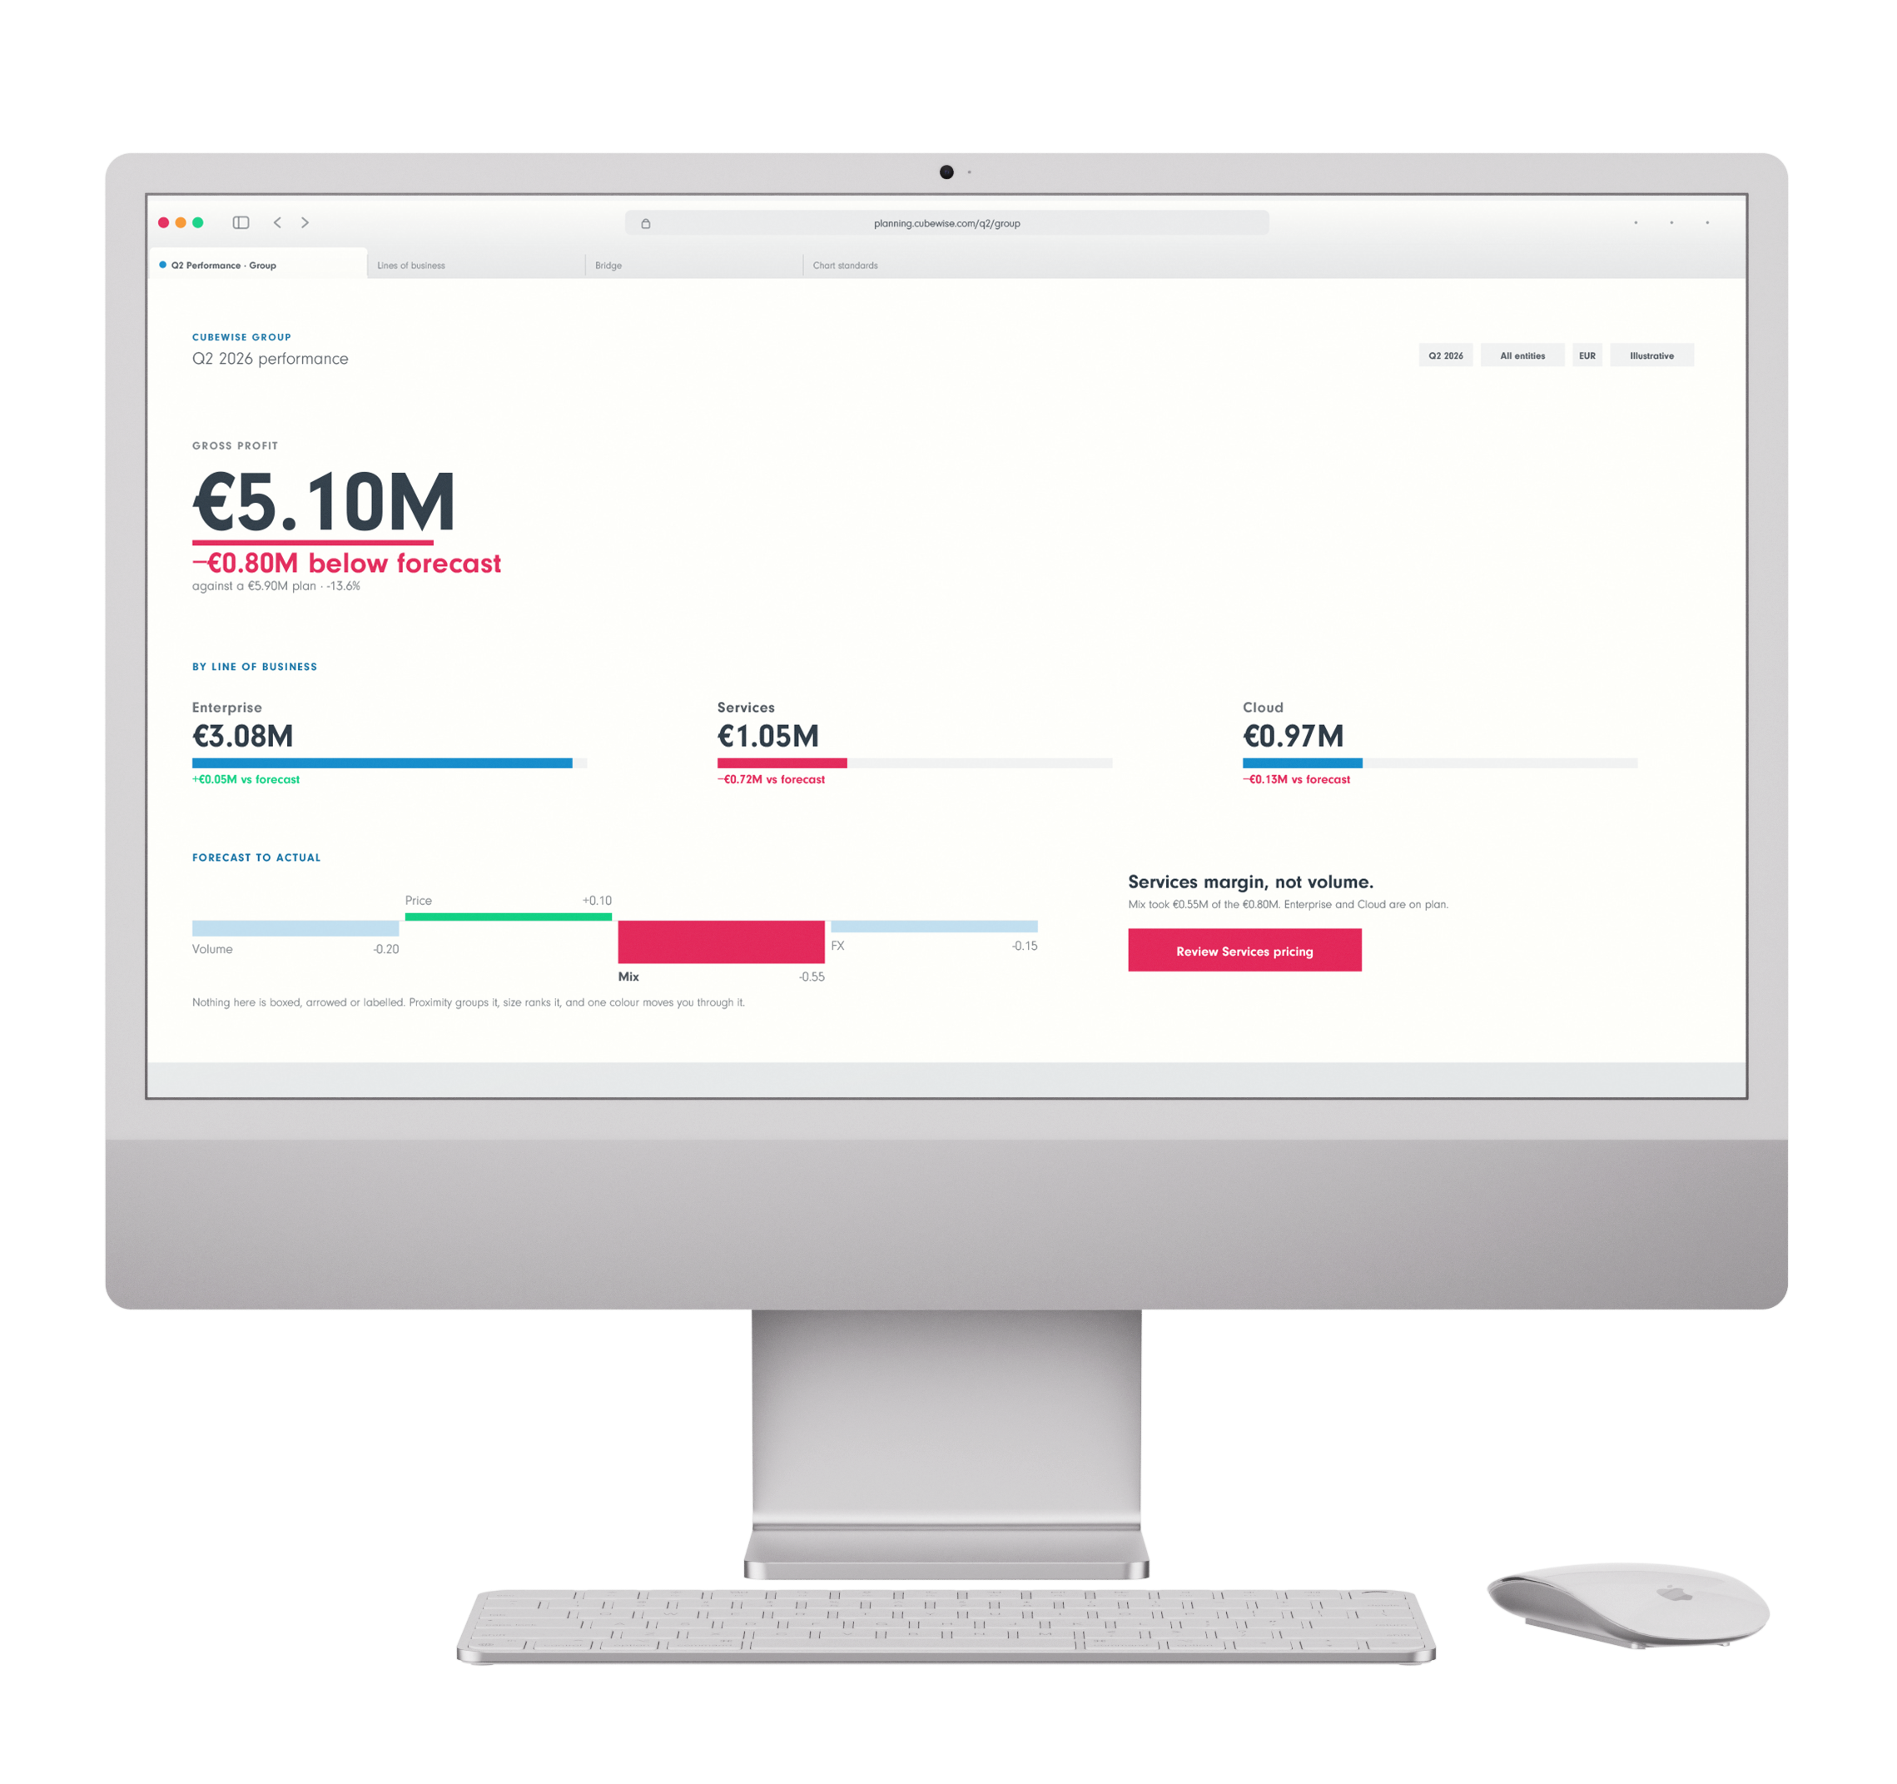
EYEBROW · ALL CAPS
Headline here.
Two or three lines.
One colour only.
Supporting copy goes here.
A second line if needed.
Third line only if the layout was built for one.
Supporting copy goes here.
SERIES OR COLUMN NAME
by Author name
Notes:
CAROUSEL CARD 2 of 13 · 1080 x 1350 · LinkedIn portrait.
WHAT TO CHANGE — the copy only. Type into the boxes. Every box already carries the right face, weight, size and tracking; restyling them is how a carousel stops looking like the others in the set.
THE HEADLINE is Neuzeit Grotesk Black, one colour, never Sky Blue (§7.7a). The accent lives in the eyebrow, a rule, or a single stat instead.
ILLUSTRATIONS are placed as pictures and were left untouched by the templatiser. Swap one with right-click → Change Picture, or delete it and let the card breathe. Build new ones with the cubewise-illustration skill so they inherit the same palette and guards.
THE CUBEWISE LOGO is canonical (§8). Do not recolour, stretch or replace it. Card 1 and card N carry it; the middle cards do not (§11.2).
SOCIAL IS SKY BLUE (§11.0) whatever the subject. Max 10 cards. Card N carries a real call to action, not a sign-off.
BACKGROUNDS group in twos to fours before switching (§7.4a). A card-by-card alternation reads as a strobe, not a rhythm.

Slide 3
EYEBROW
Headline here.
Two or three lines.
EYEBROW · ALL CAPS
EYEBROW · ALL CAPS
Label
Label
Label
Label
Label
Label
Supporting copy. Say what the reader gets and why it matters.
The payoff line. One sentence, and make it land.
SERIES OR COLUMN NAME
by Author name
Notes:
CAROUSEL CARD 3 of 13 · 1080 x 1350 · LinkedIn portrait.
WHAT TO CHANGE — the copy only. Type into the boxes. Every box already carries the right face, weight, size and tracking; restyling them is how a carousel stops looking like the others in the set.
THE HEADLINE is Neuzeit Grotesk Black, one colour, never Sky Blue (§7.7a). The accent lives in the eyebrow, a rule, or a single stat instead.
ILLUSTRATIONS are placed as pictures and were left untouched by the templatiser. Swap one with right-click → Change Picture, or delete it and let the card breathe. Build new ones with the cubewise-illustration skill so they inherit the same palette and guards.
THE CUBEWISE LOGO is canonical (§8). Do not recolour, stretch or replace it. Card 1 and card N carry it; the middle cards do not (§11.2).
SOCIAL IS SKY BLUE (§11.0) whatever the subject. Max 10 cards. Card N carries a real call to action, not a sign-off.
BACKGROUNDS group in twos to fours before switching (§7.4a). A card-by-card alternation reads as a strobe, not a rhythm.

Slide 4
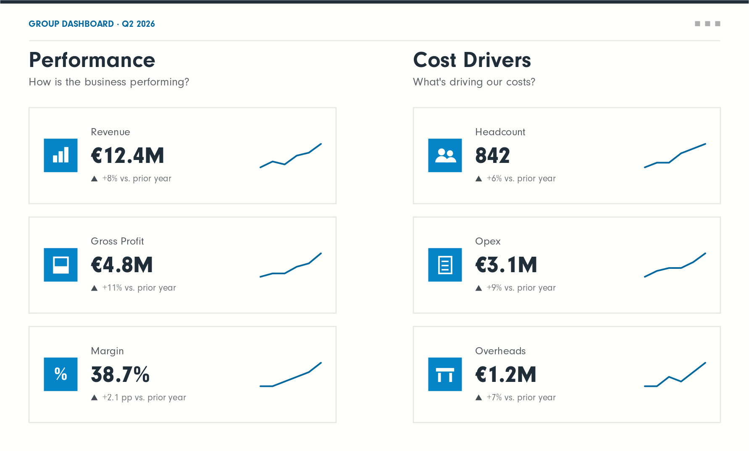
EYEBROW
Headline goes here.
Two or three lines.
Supporting copy. Say what the reader gets and why it matters.
SERIES OR COLUMN NAME
by Author name
Notes:
CAROUSEL CARD 4 of 13 · 1080 x 1350 · LinkedIn portrait.
WHAT TO CHANGE — the copy only. Type into the boxes. Every box already carries the right face, weight, size and tracking; restyling them is how a carousel stops looking like the others in the set.
THE HEADLINE is Neuzeit Grotesk Black, one colour, never Sky Blue (§7.7a). The accent lives in the eyebrow, a rule, or a single stat instead.
ILLUSTRATIONS are placed as pictures and were left untouched by the templatiser. Swap one with right-click → Change Picture, or delete it and let the card breathe. Build new ones with the cubewise-illustration skill so they inherit the same palette and guards.
THE CUBEWISE LOGO is canonical (§8). Do not recolour, stretch or replace it. Card 1 and card N carry it; the middle cards do not (§11.2).
SOCIAL IS SKY BLUE (§11.0) whatever the subject. Max 10 cards. Card N carries a real call to action, not a sign-off.
BACKGROUNDS group in twos to fours before switching (§7.4a). A card-by-card alternation reads as a strobe, not a rhythm.

Slide 5

EYEBROW
Headline here.
Two lines.
A second line if the point needs it. Two lines is the ceiling.
Third line only if the layout was built for one.
Supporting copy. Say what the reader gets and why it matters.
The payoff line. One sentence, and make it land.
SERIES OR COLUMN NAME
by Author name
Notes:
CAROUSEL CARD 5 of 13 · 1080 x 1350 · LinkedIn portrait.
WHAT TO CHANGE — the copy only. Type into the boxes. Every box already carries the right face, weight, size and tracking; restyling them is how a carousel stops looking like the others in the set.
THE HEADLINE is Neuzeit Grotesk Black, one colour, never Sky Blue (§7.7a). The accent lives in the eyebrow, a rule, or a single stat instead.
ILLUSTRATIONS are placed as pictures and were left untouched by the templatiser. Swap one with right-click → Change Picture, or delete it and let the card breathe. Build new ones with the cubewise-illustration skill so they inherit the same palette and guards.
THE CUBEWISE LOGO is canonical (§8). Do not recolour, stretch or replace it. Card 1 and card N carry it; the middle cards do not (§11.2).
SOCIAL IS SKY BLUE (§11.0) whatever the subject. Max 10 cards. Card N carries a real call to action, not a sign-off.
BACKGROUNDS group in twos to fours before switching (§7.4a). A card-by-card alternation reads as a strobe, not a rhythm.

Slide 6
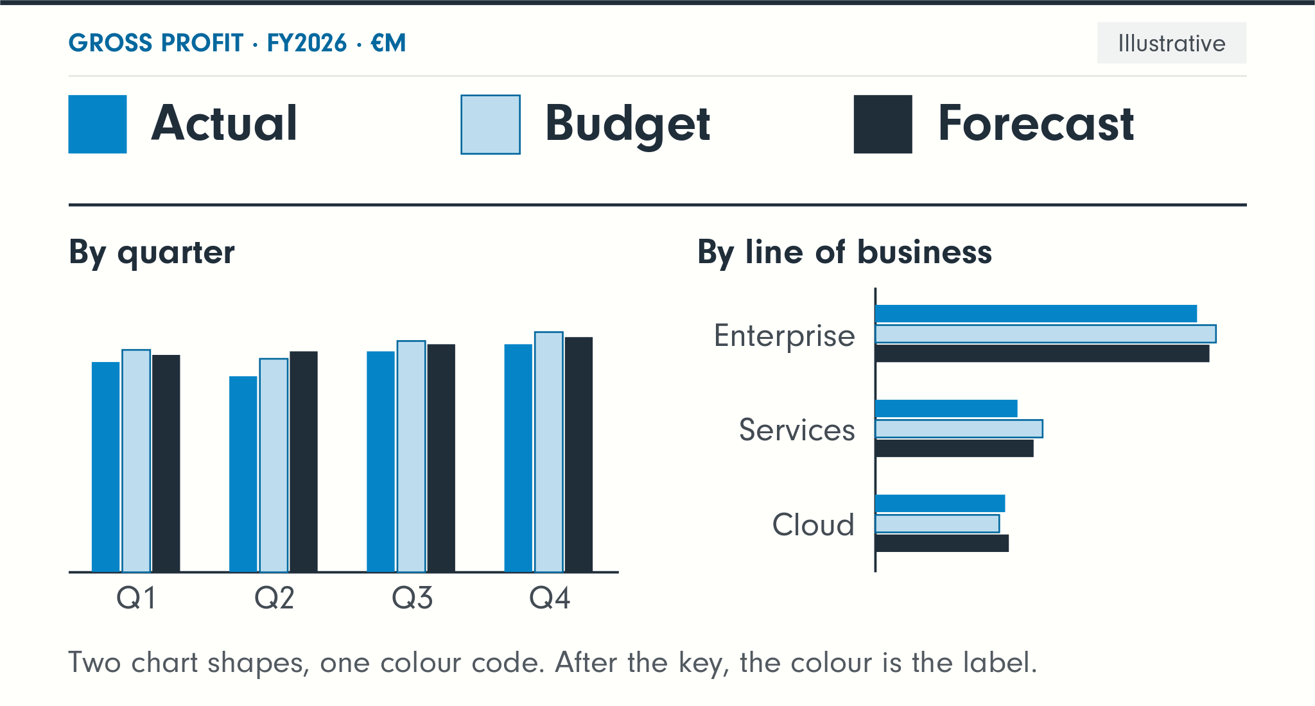
EYEBROW
Headline here.
Two lines.
Second line.
Supporting copy. Say what the reader gets and why it matters.
The payoff line.
SERIES OR COLUMN NAME
by Author name
Notes:
CAROUSEL CARD 6 of 13 · 1080 x 1350 · LinkedIn portrait.
WHAT TO CHANGE — the copy only. Type into the boxes. Every box already carries the right face, weight, size and tracking; restyling them is how a carousel stops looking like the others in the set.
THE HEADLINE is Neuzeit Grotesk Black, one colour, never Sky Blue (§7.7a). The accent lives in the eyebrow, a rule, or a single stat instead.
ILLUSTRATIONS are placed as pictures and were left untouched by the templatiser. Swap one with right-click → Change Picture, or delete it and let the card breathe. Build new ones with the cubewise-illustration skill so they inherit the same palette and guards.
THE CUBEWISE LOGO is canonical (§8). Do not recolour, stretch or replace it. Card 1 and card N carry it; the middle cards do not (§11.2).
SOCIAL IS SKY BLUE (§11.0) whatever the subject. Max 10 cards. Card N carries a real call to action, not a sign-off.
BACKGROUNDS group in twos to fours before switching (§7.4a). A card-by-card alternation reads as a strobe, not a rhythm.

Slide 7
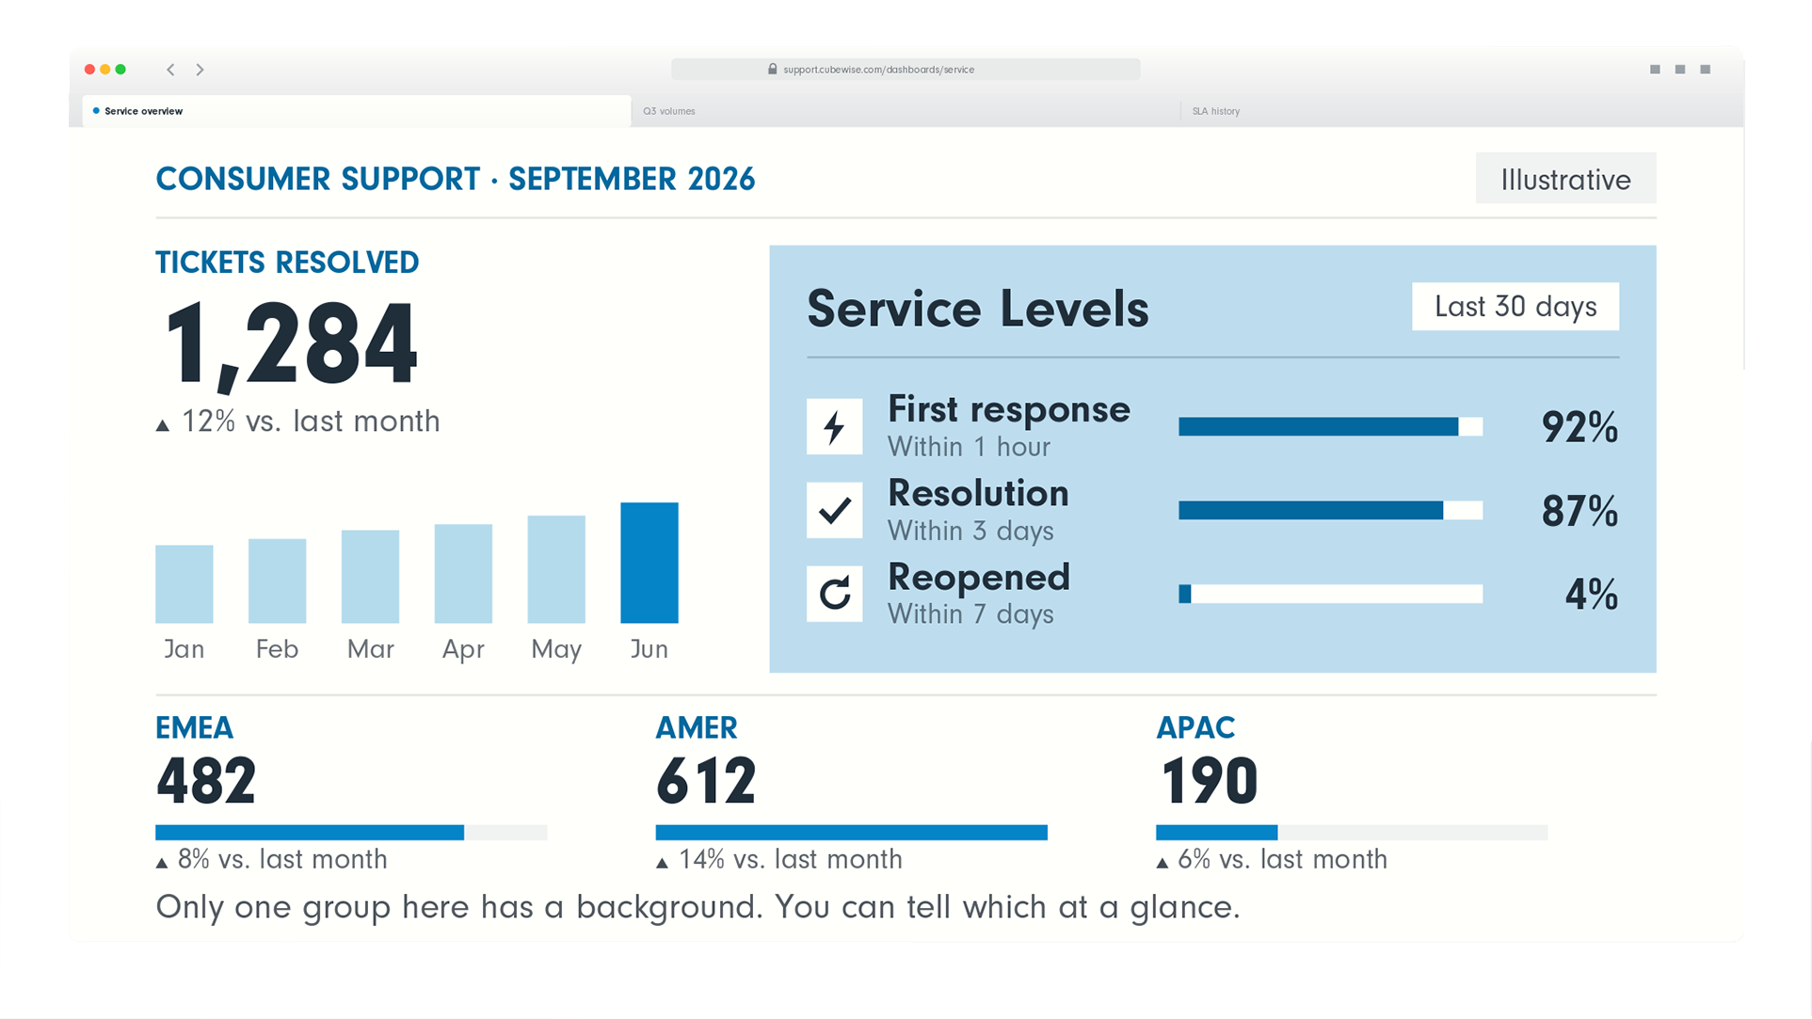
EYEBROW
Headline goes here.
Two or three lines.
Supporting copy. Say what the reader gets and why it matters.
The payoff line.
SERIES OR COLUMN NAME
by Author name
Notes:
CAROUSEL CARD 7 of 13 · 1080 x 1350 · LinkedIn portrait.
WHAT TO CHANGE — the copy only. Type into the boxes. Every box already carries the right face, weight, size and tracking; restyling them is how a carousel stops looking like the others in the set.
THE HEADLINE is Neuzeit Grotesk Black, one colour, never Sky Blue (§7.7a). The accent lives in the eyebrow, a rule, or a single stat instead.
ILLUSTRATIONS are placed as pictures and were left untouched by the templatiser. Swap one with right-click → Change Picture, or delete it and let the card breathe. Build new ones with the cubewise-illustration skill so they inherit the same palette and guards.
THE CUBEWISE LOGO is canonical (§8). Do not recolour, stretch or replace it. Card 1 and card N carry it; the middle cards do not (§11.2).
SOCIAL IS SKY BLUE (§11.0) whatever the subject. Max 10 cards. Card N carries a real call to action, not a sign-off.
BACKGROUNDS group in twos to fours before switching (§7.4a). A card-by-card alternation reads as a strobe, not a rhythm.

Slide 8
EYEBROW
Headline here.
Line.
One colour.
Keep it short.
SERIES OR COLUMN NAME
by Author name
Notes:
CAROUSEL CARD 8 of 13 · 1080 x 1350 · LinkedIn portrait.
WHAT TO CHANGE — the copy only. Type into the boxes. Every box already carries the right face, weight, size and tracking; restyling them is how a carousel stops looking like the others in the set.
THE HEADLINE is Neuzeit Grotesk Black, one colour, never Sky Blue (§7.7a). The accent lives in the eyebrow, a rule, or a single stat instead.
ILLUSTRATIONS are placed as pictures and were left untouched by the templatiser. Swap one with right-click → Change Picture, or delete it and let the card breathe. Build new ones with the cubewise-illustration skill so they inherit the same palette and guards.
THE CUBEWISE LOGO is canonical (§8). Do not recolour, stretch or replace it. Card 1 and card N carry it; the middle cards do not (§11.2).
SOCIAL IS SKY BLUE (§11.0) whatever the subject. Max 10 cards. Card N carries a real call to action, not a sign-off.
BACKGROUNDS group in twos to fours before switching (§7.4a). A card-by-card alternation reads as a strobe, not a rhythm.

Slide 9
Headline goes here.
EYEBROW · ALL CAPS
Caption.
Notes:
CAROUSEL CARD 9 of 13 · 1080 x 1350 · LinkedIn portrait.
WHAT TO CHANGE — the copy only. Type into the boxes. Every box already carries the right face, weight, size and tracking; restyling them is how a carousel stops looking like the others in the set.
THE HEADLINE is Neuzeit Grotesk Black, one colour, never Sky Blue (§7.7a). The accent lives in the eyebrow, a rule, or a single stat instead.
ILLUSTRATIONS are placed as pictures and were left untouched by the templatiser. Swap one with right-click → Change Picture, or delete it and let the card breathe. Build new ones with the cubewise-illustration skill so they inherit the same palette and guards.
THE CUBEWISE LOGO is canonical (§8). Do not recolour, stretch or replace it. Card 1 and card N carry it; the middle cards do not (§11.2).
SOCIAL IS SKY BLUE (§11.0) whatever the subject. Max 10 cards. Card N carries a real call to action, not a sign-off.
BACKGROUNDS group in twos to fours before switching (§7.4a). A card-by-card alternation reads as a strobe, not a rhythm.

Slide 10
EYEBROW · ALL CAPS
Headline goes here.
Two or three lines.
SERIES OR COLUMN NAME
by Author name
EYEBROW · ALL CAPS
EYEBROW · ALL CAPS
Supporting copy. Say what the reader gets and why it matters.
A second line if needed.
Third line, rarely.
Supporting copy goes here.
A second line if needed.
Third line, rarely.
Supporting copy goes here.
A second line if needed.
Notes:
CAROUSEL CARD 10 of 13 · 1080 x 1350 · LinkedIn portrait.
WHAT TO CHANGE — the copy only. Type into the boxes. Every box already carries the right face, weight, size and tracking; restyling them is how a carousel stops looking like the others in the set.
THE HEADLINE is Neuzeit Grotesk Black, one colour, never Sky Blue (§7.7a). The accent lives in the eyebrow, a rule, or a single stat instead.
ILLUSTRATIONS are placed as pictures and were left untouched by the templatiser. Swap one with right-click → Change Picture, or delete it and let the card breathe. Build new ones with the cubewise-illustration skill so they inherit the same palette and guards.
THE CUBEWISE LOGO is canonical (§8). Do not recolour, stretch or replace it. Card 1 and card N carry it; the middle cards do not (§11.2).
SOCIAL IS SKY BLUE (§11.0) whatever the subject. Max 10 cards. Card N carries a real call to action, not a sign-off.
BACKGROUNDS group in twos to fours before switching (§7.4a). A card-by-card alternation reads as a strobe, not a rhythm.

Slide 11
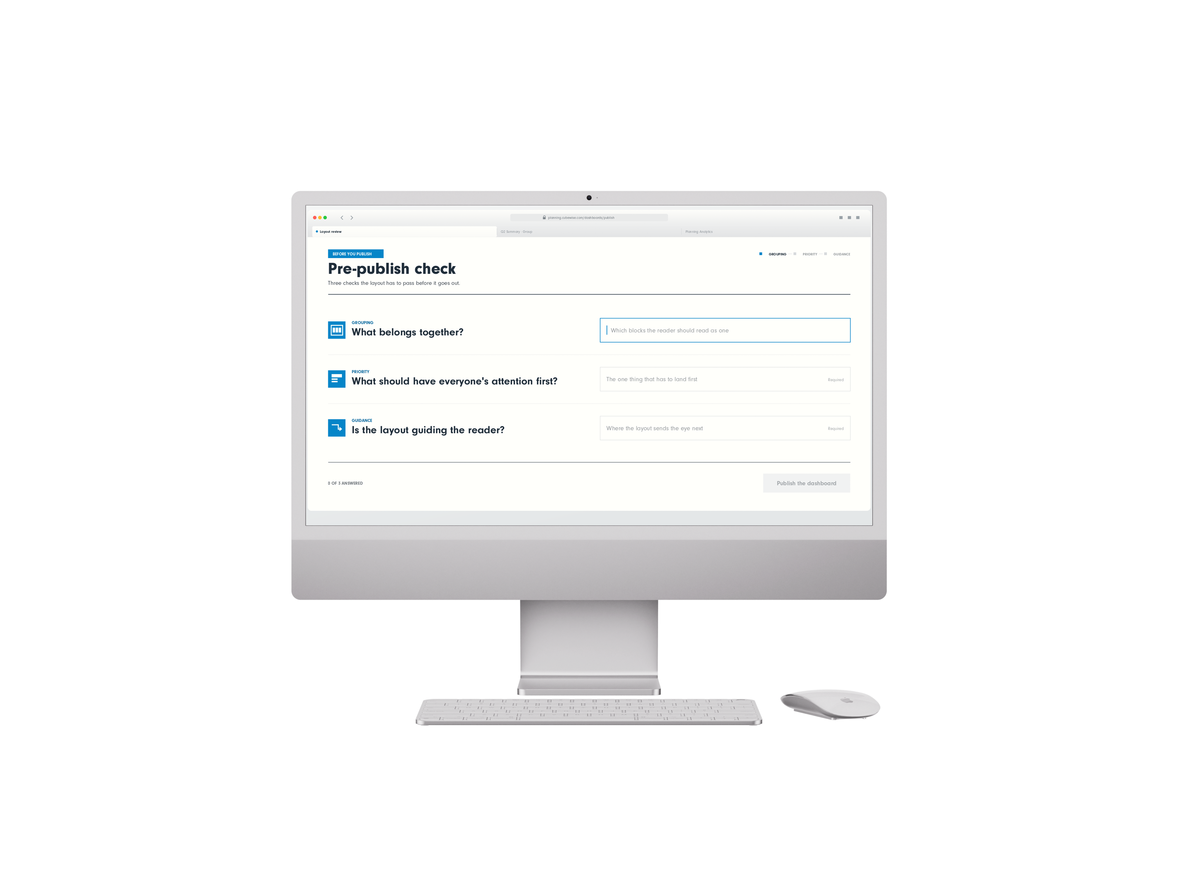
EYEBROW · ALL CAPS
Headline goes here.
Two lines.
SERIES OR COLUMN NAME
by Author name
Notes:
CAROUSEL CARD 11 of 13 · 1080 x 1350 · LinkedIn portrait.
WHAT TO CHANGE — the copy only. Type into the boxes. Every box already carries the right face, weight, size and tracking; restyling them is how a carousel stops looking like the others in the set.
THE HEADLINE is Neuzeit Grotesk Black, one colour, never Sky Blue (§7.7a). The accent lives in the eyebrow, a rule, or a single stat instead.
ILLUSTRATIONS are placed as pictures and were left untouched by the templatiser. Swap one with right-click → Change Picture, or delete it and let the card breathe. Build new ones with the cubewise-illustration skill so they inherit the same palette and guards.
THE CUBEWISE LOGO is canonical (§8). Do not recolour, stretch or replace it. Card 1 and card N carry it; the middle cards do not (§11.2).
SOCIAL IS SKY BLUE (§11.0) whatever the subject. Max 10 cards. Card N carries a real call to action, not a sign-off.
BACKGROUNDS group in twos to fours before switching (§7.4a). A card-by-card alternation reads as a strobe, not a rhythm.

Slide 12
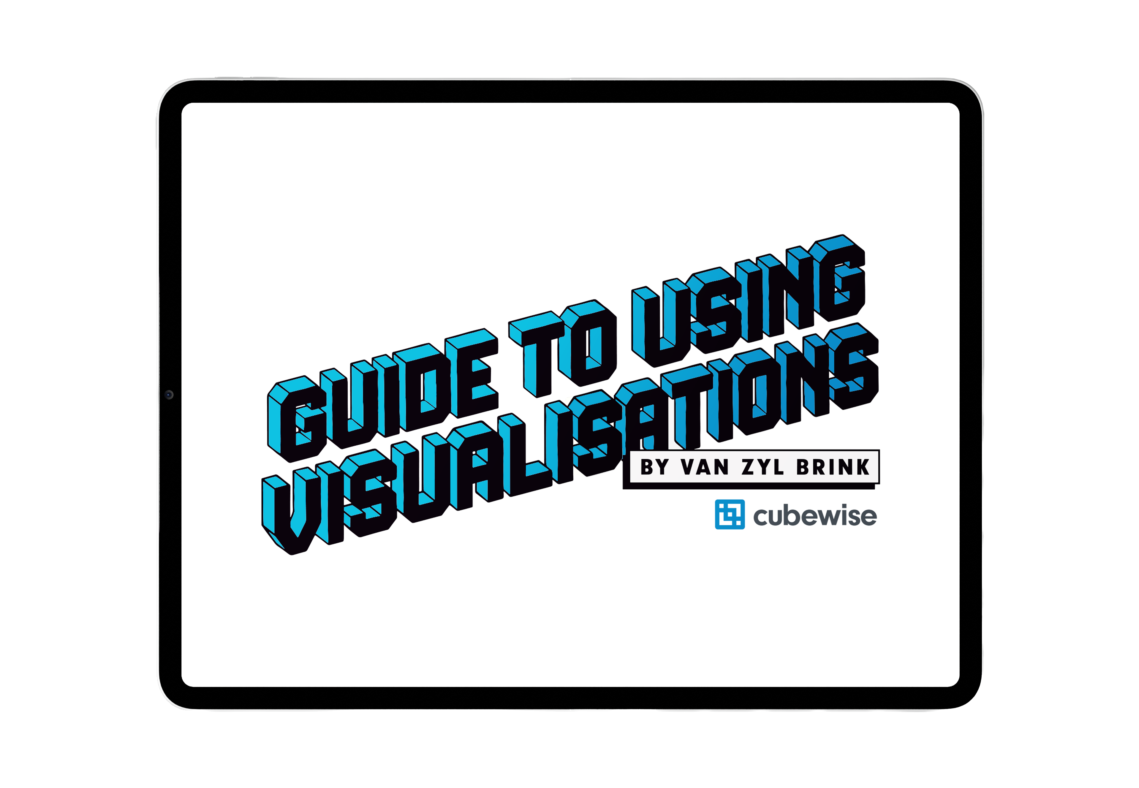
SERIES OR COLUMN NAME
by Author name
Notes:
CAROUSEL CARD 12 of 13 · 1080 x 1350 · LinkedIn portrait.
WHAT TO CHANGE — the copy only. Type into the boxes. Every box already carries the right face, weight, size and tracking; restyling them is how a carousel stops looking like the others in the set.
THE HEADLINE is Neuzeit Grotesk Black, one colour, never Sky Blue (§7.7a). The accent lives in the eyebrow, a rule, or a single stat instead.
ILLUSTRATIONS are placed as pictures and were left untouched by the templatiser. Swap one with right-click → Change Picture, or delete it and let the card breathe. Build new ones with the cubewise-illustration skill so they inherit the same palette and guards.
THE CUBEWISE LOGO is canonical (§8). Do not recolour, stretch or replace it. Card 1 and card N carry it; the middle cards do not (§11.2).
SOCIAL IS SKY BLUE (§11.0) whatever the subject. Max 10 cards. Card N carries a real call to action, not a sign-off.
BACKGROUNDS group in twos to fours before switching (§7.4a). A card-by-card alternation reads as a strobe, not a rhythm.

Slide 13
Notes:
CAROUSEL CARD 13 of 13 · 1080 x 1350 · LinkedIn portrait.
WHAT TO CHANGE — the copy only. Type into the boxes. Every box already carries the right face, weight, size and tracking; restyling them is how a carousel stops looking like the others in the set.
THE HEADLINE is Neuzeit Grotesk Black, one colour, never Sky Blue (§7.7a). The accent lives in the eyebrow, a rule, or a single stat instead.
ILLUSTRATIONS are placed as pictures and were left untouched by the templatiser. Swap one with right-click → Change Picture, or delete it and let the card breathe. Build new ones with the cubewise-illustration skill so they inherit the same palette and guards.
THE CUBEWISE LOGO is canonical (§8). Do not recolour, stretch or replace it. Card 1 and card N carry it; the middle cards do not (§11.2).
SOCIAL IS SKY BLUE (§11.0) whatever the subject. Max 10 cards. Card N carries a real call to action, not a sign-off.
BACKGROUNDS group in twos to fours before switching (§7.4a). A card-by-card alternation reads as a strobe, not a rhythm.

