Slide 1

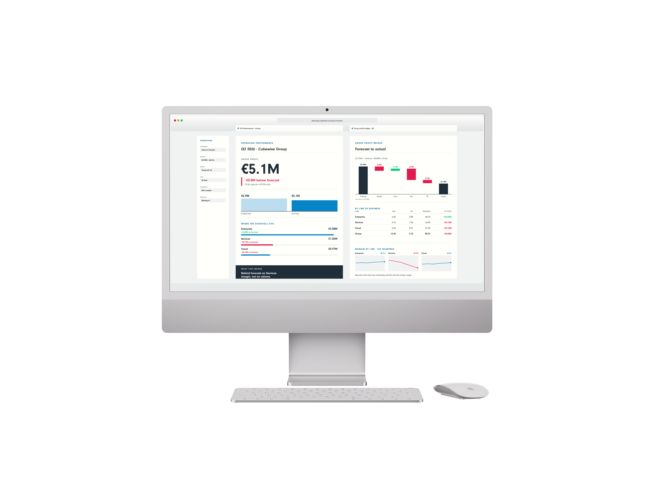
Headline here.
Two or three lines.
One colour.
Supporting copy. Say what the reader gets and why it matters.
SERIES OR COLUMN NAME
by Author name
Notes:
CAROUSEL CARD 1 of 12 · 1080 x 1350 · LinkedIn portrait.
WHAT TO CHANGE — the copy only. Type into the boxes. Every box already carries the right face, weight, size and tracking; restyling them is how a carousel stops looking like the others in the set.
THE HEADLINE is Neuzeit Grotesk Black, one colour, never Sky Blue (§7.7a). The accent lives in the eyebrow, a rule, or a single stat instead.
ILLUSTRATIONS are placed as pictures and were left untouched by the templatiser. Swap one with right-click → Change Picture, or delete it and let the card breathe. Build new ones with the cubewise-illustration skill so they inherit the same palette and guards.
THE CUBEWISE LOGO is canonical (§8). Do not recolour, stretch or replace it. Card 1 and card N carry it; the middle cards do not (§11.2).
SOCIAL IS SKY BLUE (§11.0) whatever the subject. Max 10 cards. Card N carries a real call to action, not a sign-off.
BACKGROUNDS group in twos to fours before switching (§7.4a). A card-by-card alternation reads as a strobe, not a rhythm.

Slide 2
EYEBROW
Headline goes here.
The payoff line.
Supporting copy. Say what the reader gets and why it matters.
SERIES OR COLUMN NAME
by Author name
Notes:
CAROUSEL CARD 2 of 12 · 1080 x 1350 · LinkedIn portrait.
WHAT TO CHANGE — the copy only. Type into the boxes. Every box already carries the right face, weight, size and tracking; restyling them is how a carousel stops looking like the others in the set.
THE HEADLINE is Neuzeit Grotesk Black, one colour, never Sky Blue (§7.7a). The accent lives in the eyebrow, a rule, or a single stat instead.
ILLUSTRATIONS are placed as pictures and were left untouched by the templatiser. Swap one with right-click → Change Picture, or delete it and let the card breathe. Build new ones with the cubewise-illustration skill so they inherit the same palette and guards.
THE CUBEWISE LOGO is canonical (§8). Do not recolour, stretch or replace it. Card 1 and card N carry it; the middle cards do not (§11.2).
SOCIAL IS SKY BLUE (§11.0) whatever the subject. Max 10 cards. Card N carries a real call to action, not a sign-off.
BACKGROUNDS group in twos to fours before switching (§7.4a). A card-by-card alternation reads as a strobe, not a rhythm.

Slide 3
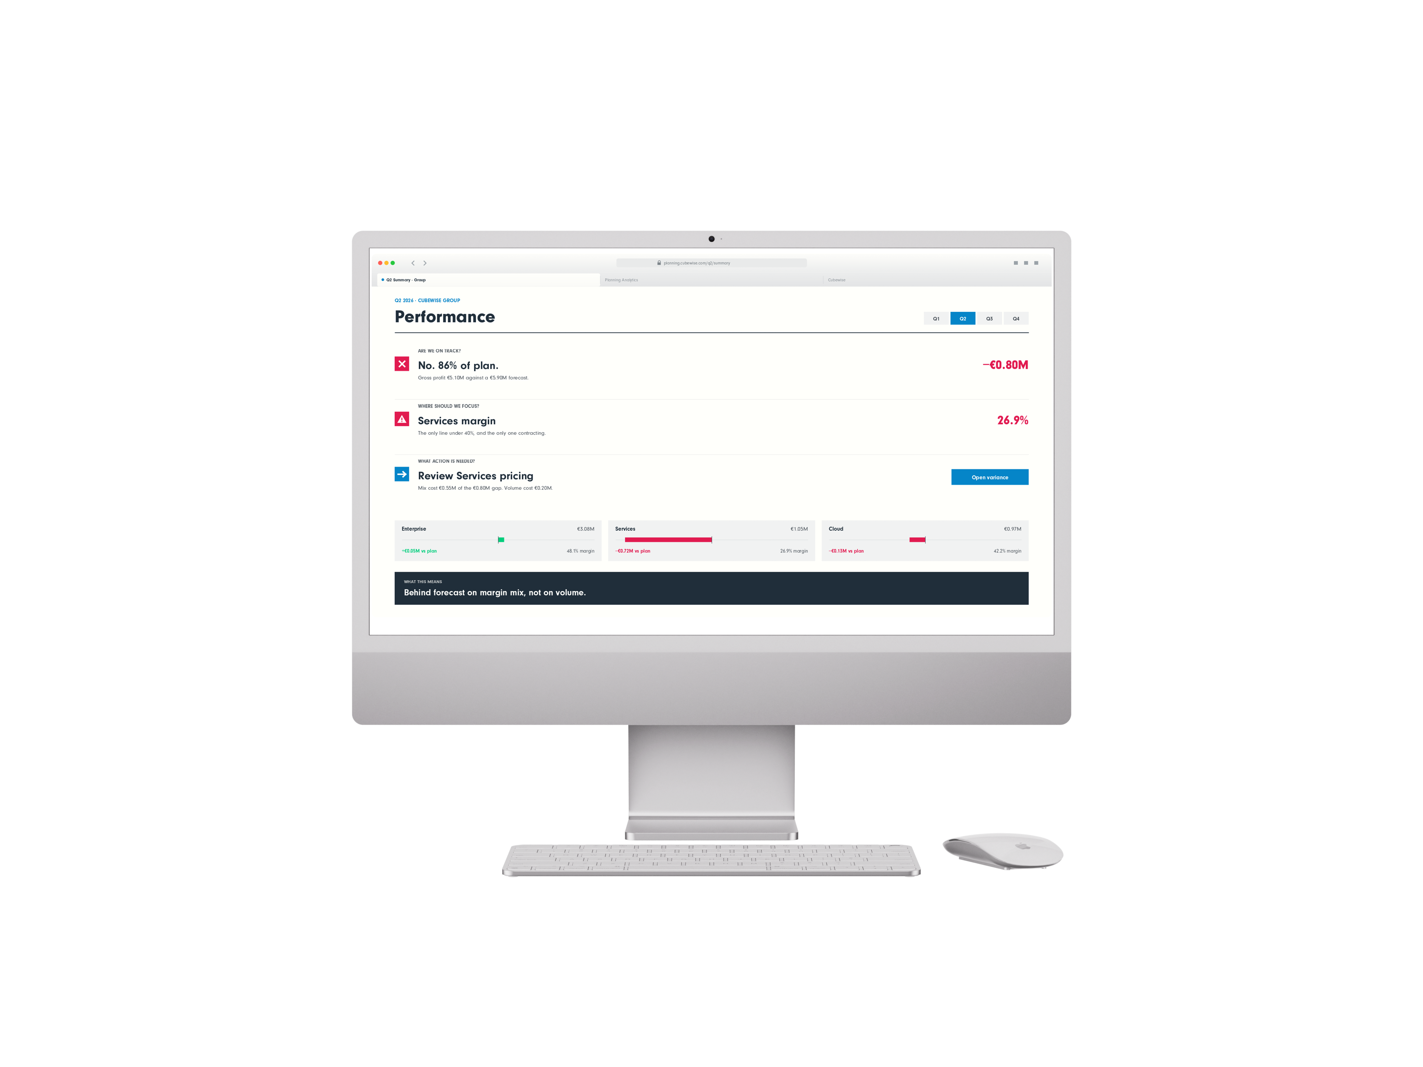
EYEBROW · ALL CAPS
Supporting copy goes here.
A second line if needed.
Third line only if the layout was built for one.
Headline goes here.
SERIES OR COLUMN NAME
by Author name
Notes:
CAROUSEL CARD 3 of 12 · 1080 x 1350 · LinkedIn portrait.
WHAT TO CHANGE — the copy only. Type into the boxes. Every box already carries the right face, weight, size and tracking; restyling them is how a carousel stops looking like the others in the set.
THE HEADLINE is Neuzeit Grotesk Black, one colour, never Sky Blue (§7.7a). The accent lives in the eyebrow, a rule, or a single stat instead.
ILLUSTRATIONS are placed as pictures and were left untouched by the templatiser. Swap one with right-click → Change Picture, or delete it and let the card breathe. Build new ones with the cubewise-illustration skill so they inherit the same palette and guards.
THE CUBEWISE LOGO is canonical (§8). Do not recolour, stretch or replace it. Card 1 and card N carry it; the middle cards do not (§11.2).
SOCIAL IS SKY BLUE (§11.0) whatever the subject. Max 10 cards. Card N carries a real call to action, not a sign-off.
BACKGROUNDS group in twos to fours before switching (§7.4a). A card-by-card alternation reads as a strobe, not a rhythm.

Slide 4
EYEBROW
Headline.
The payoff line.
Supporting copy. Say what the reader gets and why it matters.
SERIES OR COLUMN NAME
by Author name
Notes:
CAROUSEL CARD 4 of 12 · 1080 x 1350 · LinkedIn portrait.
WHAT TO CHANGE — the copy only. Type into the boxes. Every box already carries the right face, weight, size and tracking; restyling them is how a carousel stops looking like the others in the set.
THE HEADLINE is Neuzeit Grotesk Black, one colour, never Sky Blue (§7.7a). The accent lives in the eyebrow, a rule, or a single stat instead.
ILLUSTRATIONS are placed as pictures and were left untouched by the templatiser. Swap one with right-click → Change Picture, or delete it and let the card breathe. Build new ones with the cubewise-illustration skill so they inherit the same palette and guards.
THE CUBEWISE LOGO is canonical (§8). Do not recolour, stretch or replace it. Card 1 and card N carry it; the middle cards do not (§11.2).
SOCIAL IS SKY BLUE (§11.0) whatever the subject. Max 10 cards. Card N carries a real call to action, not a sign-off.
BACKGROUNDS group in twos to fours before switching (§7.4a). A card-by-card alternation reads as a strobe, not a rhythm.

Slide 5
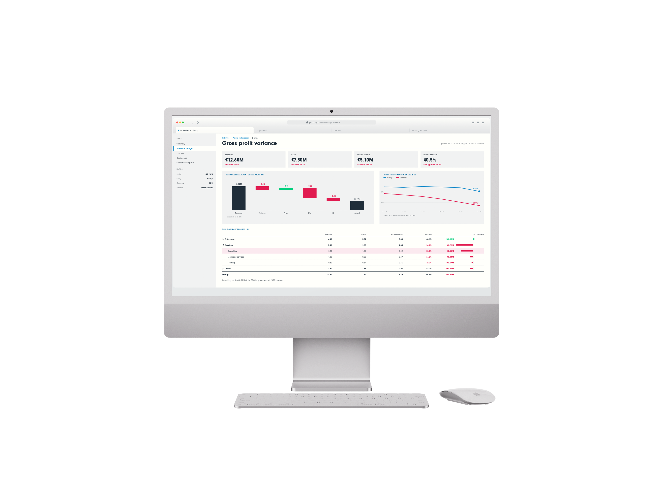
EYEBROW · ALL CAPS
Supporting copy goes here.
A second line if needed.
Third line only if the layout was built for one.
Headline goes here.
SERIES OR COLUMN NAME
by Author name
Notes:
CAROUSEL CARD 5 of 12 · 1080 x 1350 · LinkedIn portrait.
WHAT TO CHANGE — the copy only. Type into the boxes. Every box already carries the right face, weight, size and tracking; restyling them is how a carousel stops looking like the others in the set.
THE HEADLINE is Neuzeit Grotesk Black, one colour, never Sky Blue (§7.7a). The accent lives in the eyebrow, a rule, or a single stat instead.
ILLUSTRATIONS are placed as pictures and were left untouched by the templatiser. Swap one with right-click → Change Picture, or delete it and let the card breathe. Build new ones with the cubewise-illustration skill so they inherit the same palette and guards.
THE CUBEWISE LOGO is canonical (§8). Do not recolour, stretch or replace it. Card 1 and card N carry it; the middle cards do not (§11.2).
SOCIAL IS SKY BLUE (§11.0) whatever the subject. Max 10 cards. Card N carries a real call to action, not a sign-off.
BACKGROUNDS group in twos to fours before switching (§7.4a). A card-by-card alternation reads as a strobe, not a rhythm.

Slide 6
Supporting copy. Say what the reader gets and why it matters.
SERIES OR COLUMN NAME
by Author name
Notes:
CAROUSEL CARD 6 of 12 · 1080 x 1350 · LinkedIn portrait.
WHAT TO CHANGE — the copy only. Type into the boxes. Every box already carries the right face, weight, size and tracking; restyling them is how a carousel stops looking like the others in the set.
THE HEADLINE is Neuzeit Grotesk Black, one colour, never Sky Blue (§7.7a). The accent lives in the eyebrow, a rule, or a single stat instead.
ILLUSTRATIONS are placed as pictures and were left untouched by the templatiser. Swap one with right-click → Change Picture, or delete it and let the card breathe. Build new ones with the cubewise-illustration skill so they inherit the same palette and guards.
THE CUBEWISE LOGO is canonical (§8). Do not recolour, stretch or replace it. Card 1 and card N carry it; the middle cards do not (§11.2).
SOCIAL IS SKY BLUE (§11.0) whatever the subject. Max 10 cards. Card N carries a real call to action, not a sign-off.
BACKGROUNDS group in twos to fours before switching (§7.4a). A card-by-card alternation reads as a strobe, not a rhythm.

Slide 7
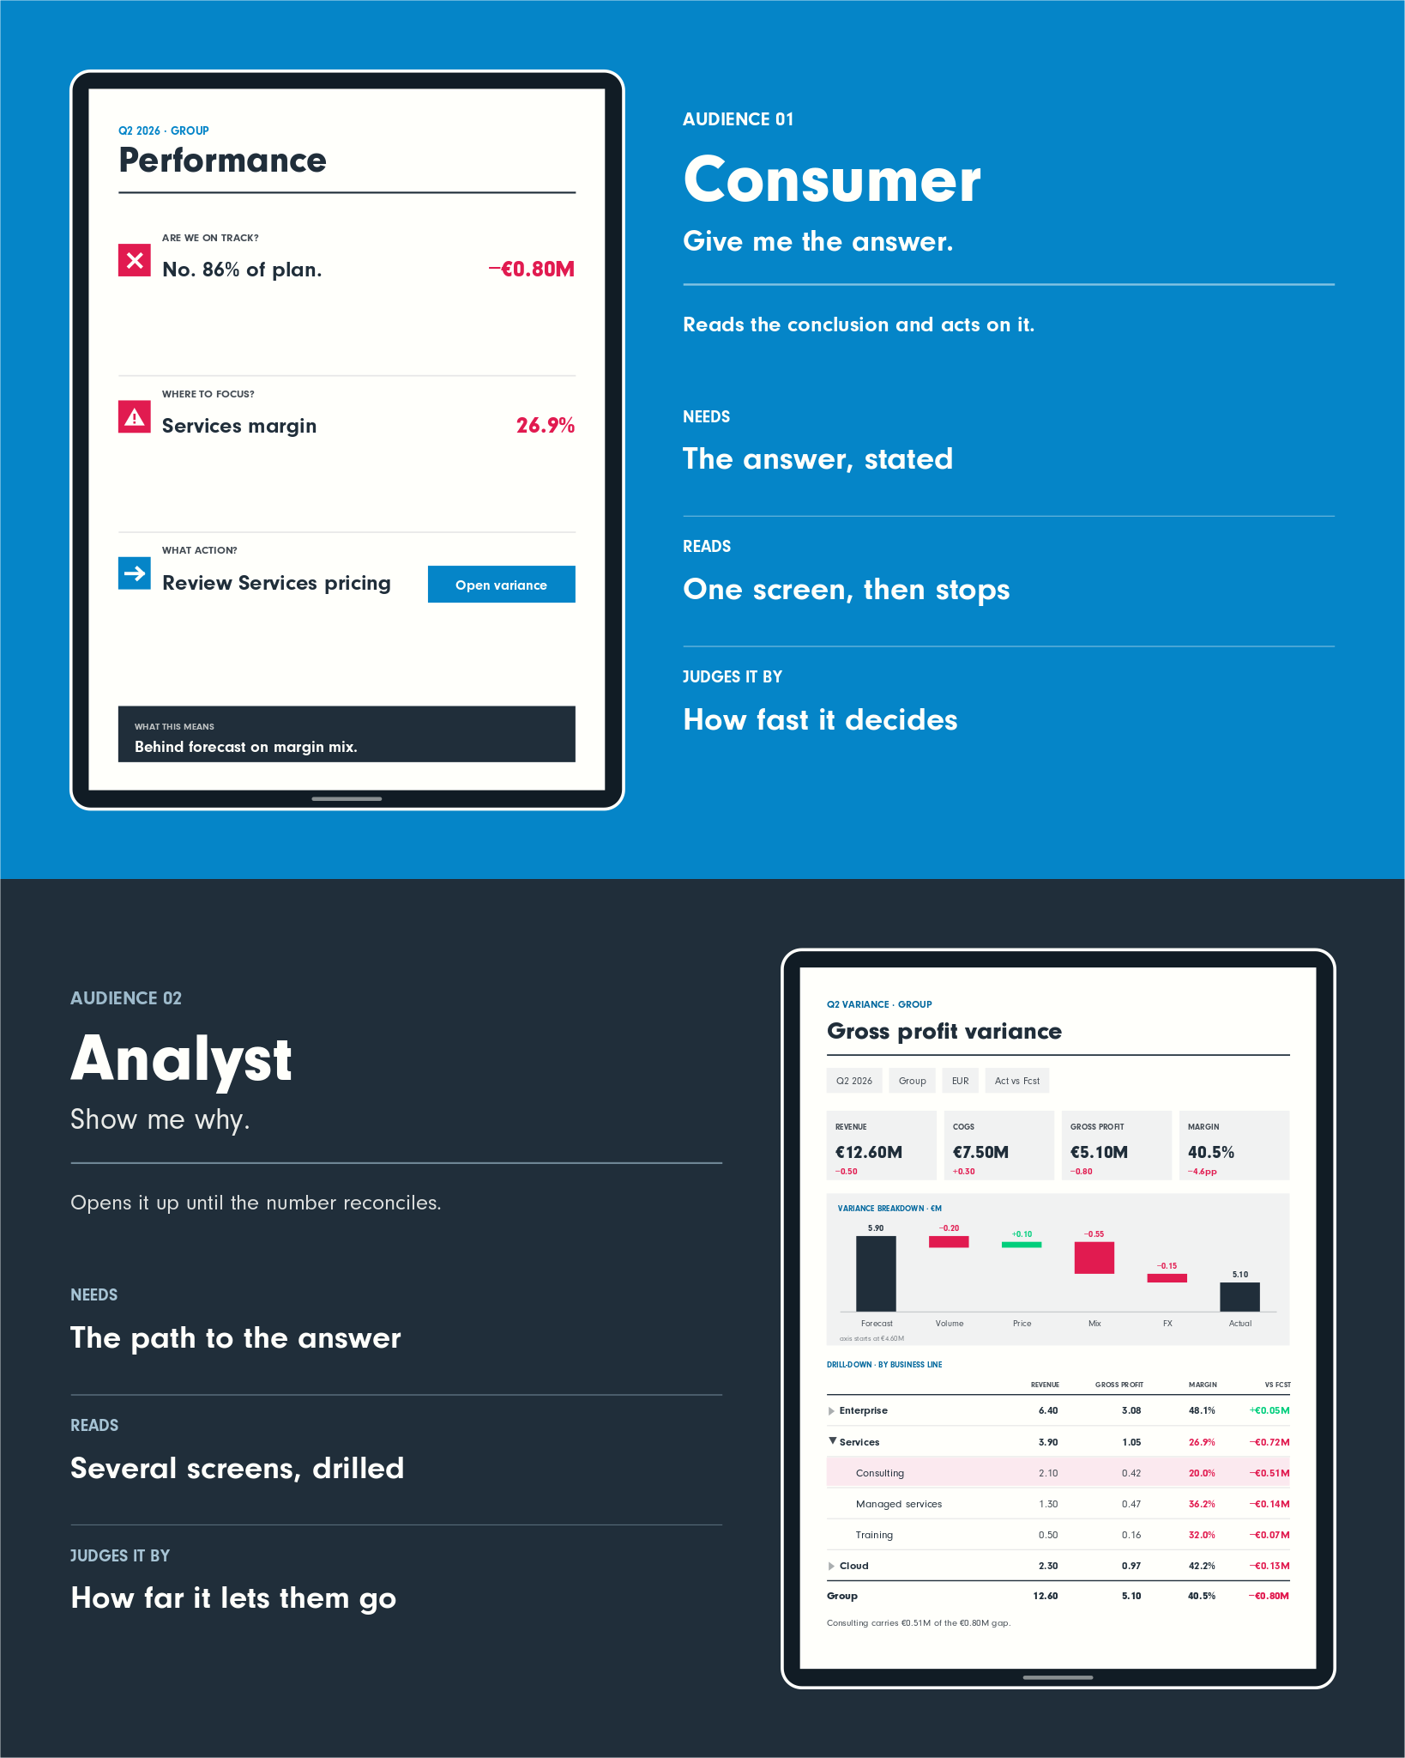
Supporting copy. Say what the reader gets and why it matters.
SERIES OR COLUMN NAME
by Author name
Notes:
CAROUSEL CARD 7 of 12 · 1080 x 1350 · LinkedIn portrait.
WHAT TO CHANGE — the copy only. Type into the boxes. Every box already carries the right face, weight, size and tracking; restyling them is how a carousel stops looking like the others in the set.
THE HEADLINE is Neuzeit Grotesk Black, one colour, never Sky Blue (§7.7a). The accent lives in the eyebrow, a rule, or a single stat instead.
ILLUSTRATIONS are placed as pictures and were left untouched by the templatiser. Swap one with right-click → Change Picture, or delete it and let the card breathe. Build new ones with the cubewise-illustration skill so they inherit the same palette and guards.
THE CUBEWISE LOGO is canonical (§8). Do not recolour, stretch or replace it. Card 1 and card N carry it; the middle cards do not (§11.2).
SOCIAL IS SKY BLUE (§11.0) whatever the subject. Max 10 cards. Card N carries a real call to action, not a sign-off.
BACKGROUNDS group in twos to fours before switching (§7.4a). A card-by-card alternation reads as a strobe, not a rhythm.

Slide 8
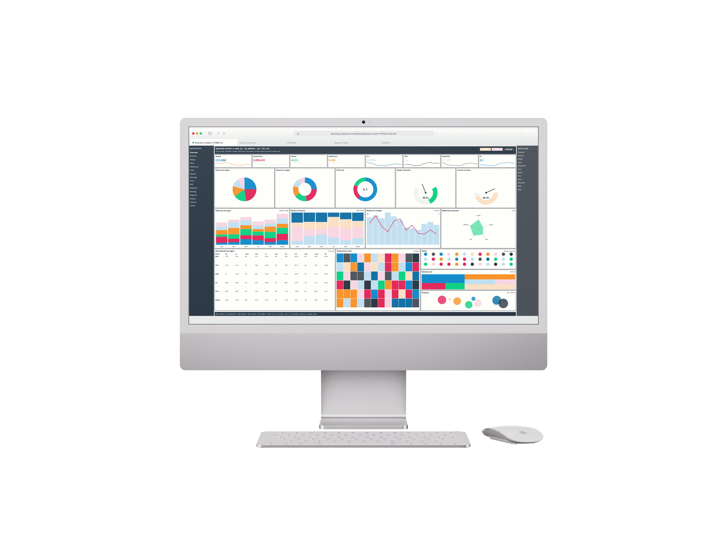
EYEBROW · ALL CAPS
Headline.
Supporting copy. Say what the reader gets and why it matters.
SERIES OR COLUMN NAME
by Author name
Notes:
CAROUSEL CARD 8 of 12 · 1080 x 1350 · LinkedIn portrait.
WHAT TO CHANGE — the copy only. Type into the boxes. Every box already carries the right face, weight, size and tracking; restyling them is how a carousel stops looking like the others in the set.
THE HEADLINE is Neuzeit Grotesk Black, one colour, never Sky Blue (§7.7a). The accent lives in the eyebrow, a rule, or a single stat instead.
ILLUSTRATIONS are placed as pictures and were left untouched by the templatiser. Swap one with right-click → Change Picture, or delete it and let the card breathe. Build new ones with the cubewise-illustration skill so they inherit the same palette and guards.
THE CUBEWISE LOGO is canonical (§8). Do not recolour, stretch or replace it. Card 1 and card N carry it; the middle cards do not (§11.2).
SOCIAL IS SKY BLUE (§11.0) whatever the subject. Max 10 cards. Card N carries a real call to action, not a sign-off.
BACKGROUNDS group in twos to fours before switching (§7.4a). A card-by-card alternation reads as a strobe, not a rhythm.

Slide 9
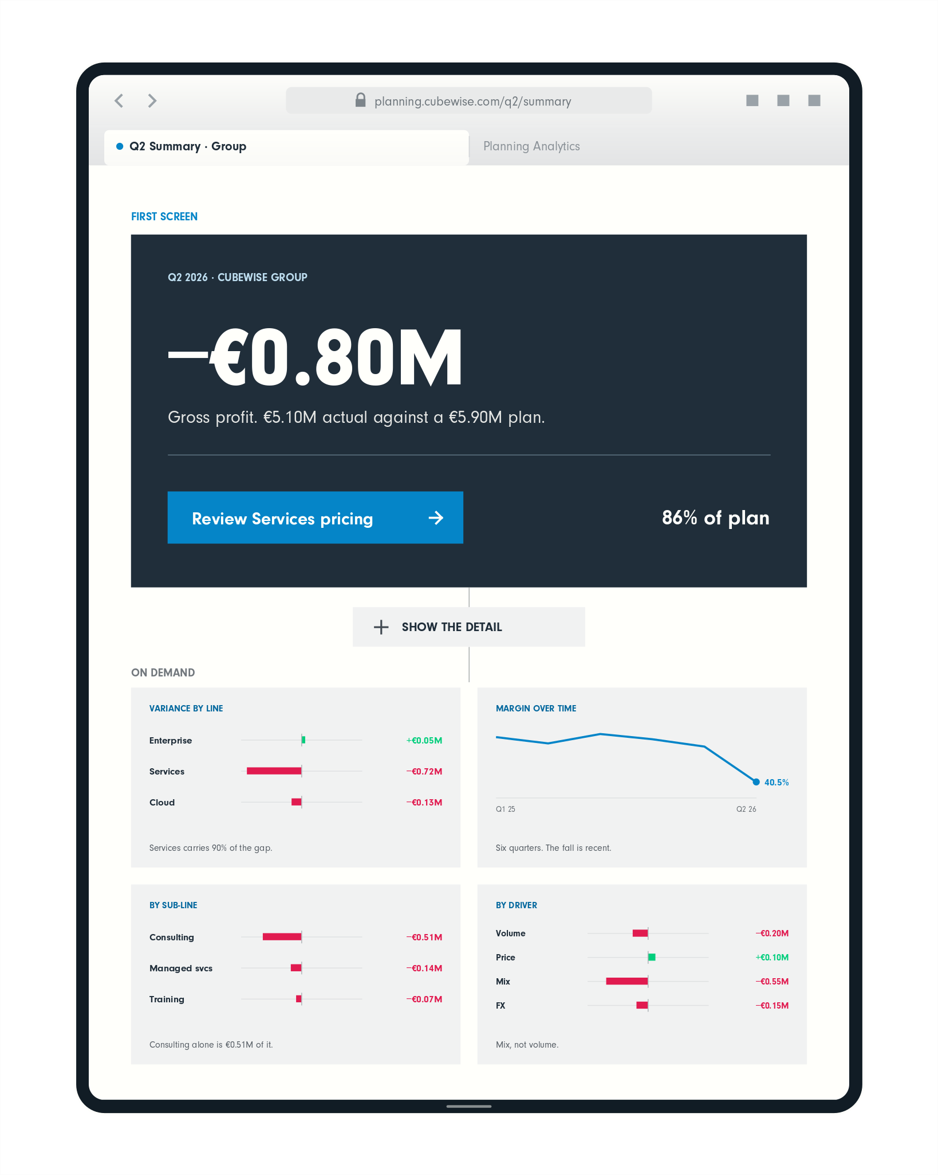
EYEBROW · ALL CAPS
Headline here.
Two or three lines.
SERIES OR COLUMN NAME
by Author name
Notes:
CAROUSEL CARD 9 of 12 · 1080 x 1350 · LinkedIn portrait.
WHAT TO CHANGE — the copy only. Type into the boxes. Every box already carries the right face, weight, size and tracking; restyling them is how a carousel stops looking like the others in the set.
THE HEADLINE is Neuzeit Grotesk Black, one colour, never Sky Blue (§7.7a). The accent lives in the eyebrow, a rule, or a single stat instead.
ILLUSTRATIONS are placed as pictures and were left untouched by the templatiser. Swap one with right-click → Change Picture, or delete it and let the card breathe. Build new ones with the cubewise-illustration skill so they inherit the same palette and guards.
THE CUBEWISE LOGO is canonical (§8). Do not recolour, stretch or replace it. Card 1 and card N carry it; the middle cards do not (§11.2).
SOCIAL IS SKY BLUE (§11.0) whatever the subject. Max 10 cards. Card N carries a real call to action, not a sign-off.
BACKGROUNDS group in twos to fours before switching (§7.4a). A card-by-card alternation reads as a strobe, not a rhythm.

Slide 10
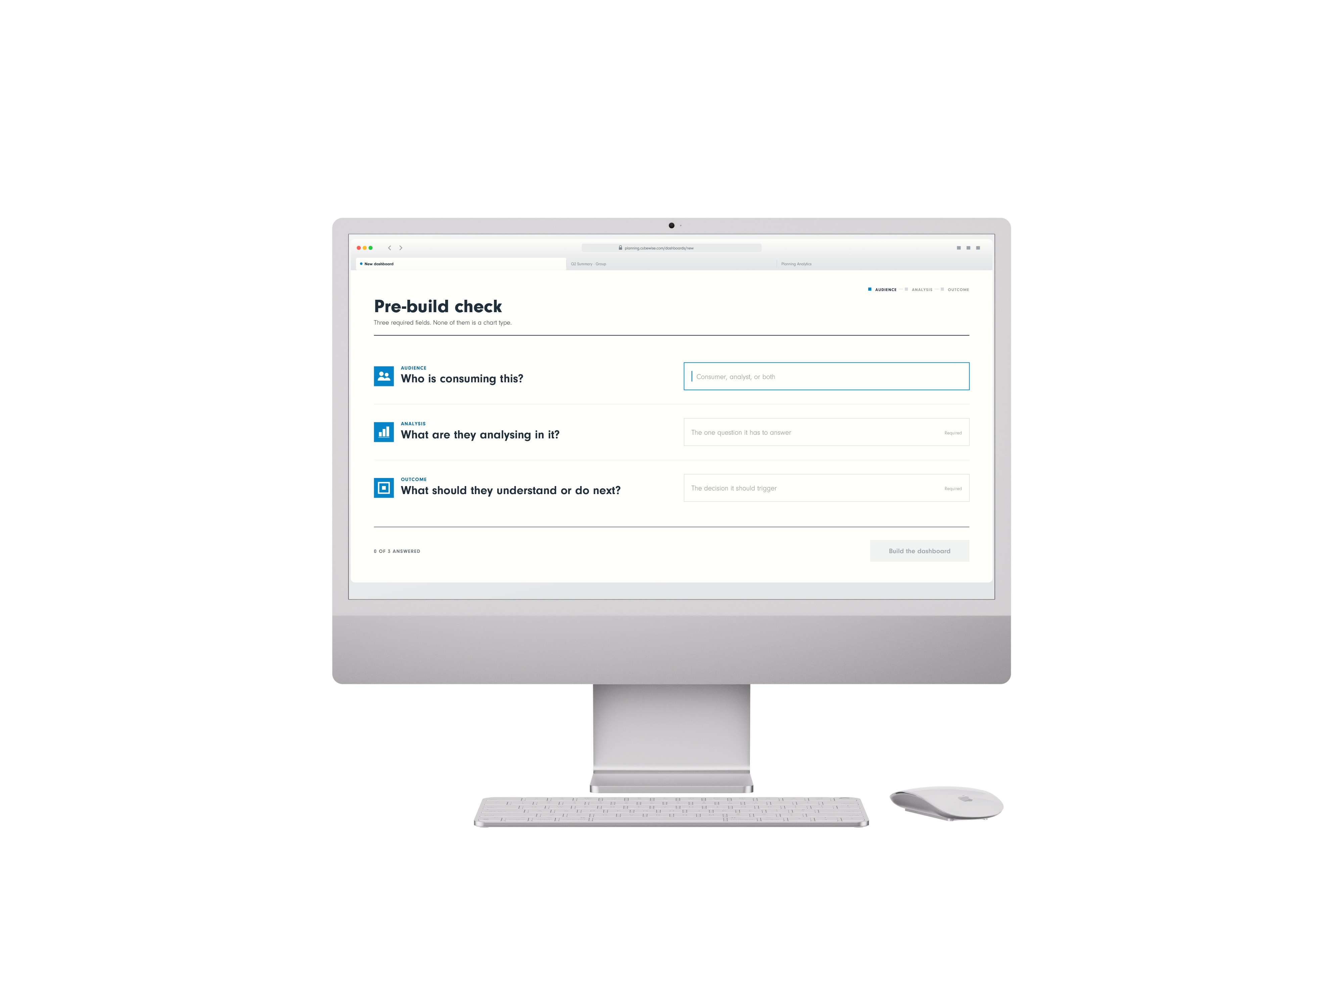
EYEBROW · ALL CAPS
Headline here.
Two or three lines.
SERIES OR COLUMN NAME
by Author name
Notes:
CAROUSEL CARD 10 of 12 · 1080 x 1350 · LinkedIn portrait.
WHAT TO CHANGE — the copy only. Type into the boxes. Every box already carries the right face, weight, size and tracking; restyling them is how a carousel stops looking like the others in the set.
THE HEADLINE is Neuzeit Grotesk Black, one colour, never Sky Blue (§7.7a). The accent lives in the eyebrow, a rule, or a single stat instead.
ILLUSTRATIONS are placed as pictures and were left untouched by the templatiser. Swap one with right-click → Change Picture, or delete it and let the card breathe. Build new ones with the cubewise-illustration skill so they inherit the same palette and guards.
THE CUBEWISE LOGO is canonical (§8). Do not recolour, stretch or replace it. Card 1 and card N carry it; the middle cards do not (§11.2).
SOCIAL IS SKY BLUE (§11.0) whatever the subject. Max 10 cards. Card N carries a real call to action, not a sign-off.
BACKGROUNDS group in twos to fours before switching (§7.4a). A card-by-card alternation reads as a strobe, not a rhythm.

Slide 11

SERIES OR COLUMN NAME
by Author name
Notes:
CAROUSEL CARD 11 of 12 · 1080 x 1350 · LinkedIn portrait.
WHAT TO CHANGE — the copy only. Type into the boxes. Every box already carries the right face, weight, size and tracking; restyling them is how a carousel stops looking like the others in the set.
THE HEADLINE is Neuzeit Grotesk Black, one colour, never Sky Blue (§7.7a). The accent lives in the eyebrow, a rule, or a single stat instead.
ILLUSTRATIONS are placed as pictures and were left untouched by the templatiser. Swap one with right-click → Change Picture, or delete it and let the card breathe. Build new ones with the cubewise-illustration skill so they inherit the same palette and guards.
THE CUBEWISE LOGO is canonical (§8). Do not recolour, stretch or replace it. Card 1 and card N carry it; the middle cards do not (§11.2).
SOCIAL IS SKY BLUE (§11.0) whatever the subject. Max 10 cards. Card N carries a real call to action, not a sign-off.
BACKGROUNDS group in twos to fours before switching (§7.4a). A card-by-card alternation reads as a strobe, not a rhythm.

Slide 12
Notes:
CAROUSEL CARD 12 of 12 · 1080 x 1350 · LinkedIn portrait.
WHAT TO CHANGE — the copy only. Type into the boxes. Every box already carries the right face, weight, size and tracking; restyling them is how a carousel stops looking like the others in the set.
THE HEADLINE is Neuzeit Grotesk Black, one colour, never Sky Blue (§7.7a). The accent lives in the eyebrow, a rule, or a single stat instead.
ILLUSTRATIONS are placed as pictures and were left untouched by the templatiser. Swap one with right-click → Change Picture, or delete it and let the card breathe. Build new ones with the cubewise-illustration skill so they inherit the same palette and guards.
THE CUBEWISE LOGO is canonical (§8). Do not recolour, stretch or replace it. Card 1 and card N carry it; the middle cards do not (§11.2).
SOCIAL IS SKY BLUE (§11.0) whatever the subject. Max 10 cards. Card N carries a real call to action, not a sign-off.
BACKGROUNDS group in twos to fours before switching (§7.4a). A card-by-card alternation reads as a strobe, not a rhythm.

