Slide 1

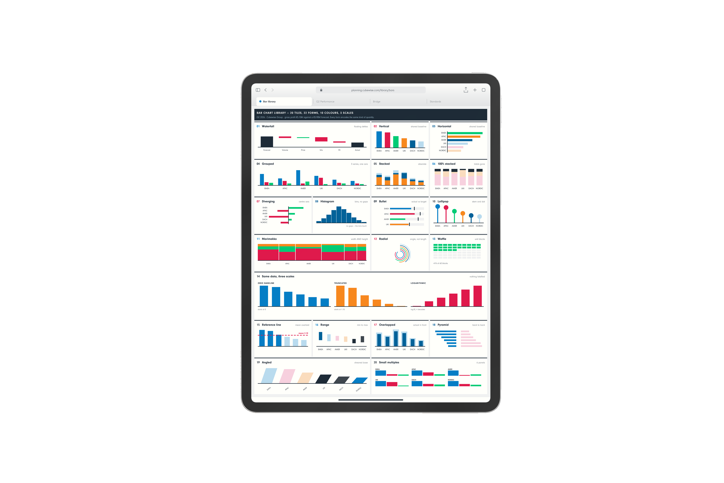
Headline goes here.
Two lines.
One colour.
Supporting copy. Say what the reader gets and why it matters.
Caption or note.
EYEBROW · ALL CAPS
Notes:
CAROUSEL CARD 1 of 11 · 1080 x 1350 · LinkedIn portrait.
WHAT TO CHANGE — the copy only. Type into the boxes. Every box already carries the right face, weight, size and tracking; restyling them is how a carousel stops looking like the others in the set.
THE HEADLINE is Neuzeit Grotesk Black, one colour, never Sky Blue (§7.7a). The accent lives in the eyebrow, a rule, or a single stat instead.
ILLUSTRATIONS are placed as pictures and were left untouched by the templatiser. Swap one with right-click → Change Picture, or delete it and let the card breathe. Build new ones with the cubewise-illustration skill so they inherit the same palette and guards.
THE CUBEWISE LOGO is canonical (§8). Do not recolour, stretch or replace it. Card 1 and card N carry it; the middle cards do not (§11.2).
SOCIAL IS SKY BLUE (§11.0) whatever the subject. Max 10 cards. Card N carries a real call to action, not a sign-off.
BACKGROUNDS group in twos to fours before switching (§7.4a). A card-by-card alternation reads as a strobe, not a rhythm.

Slide 2
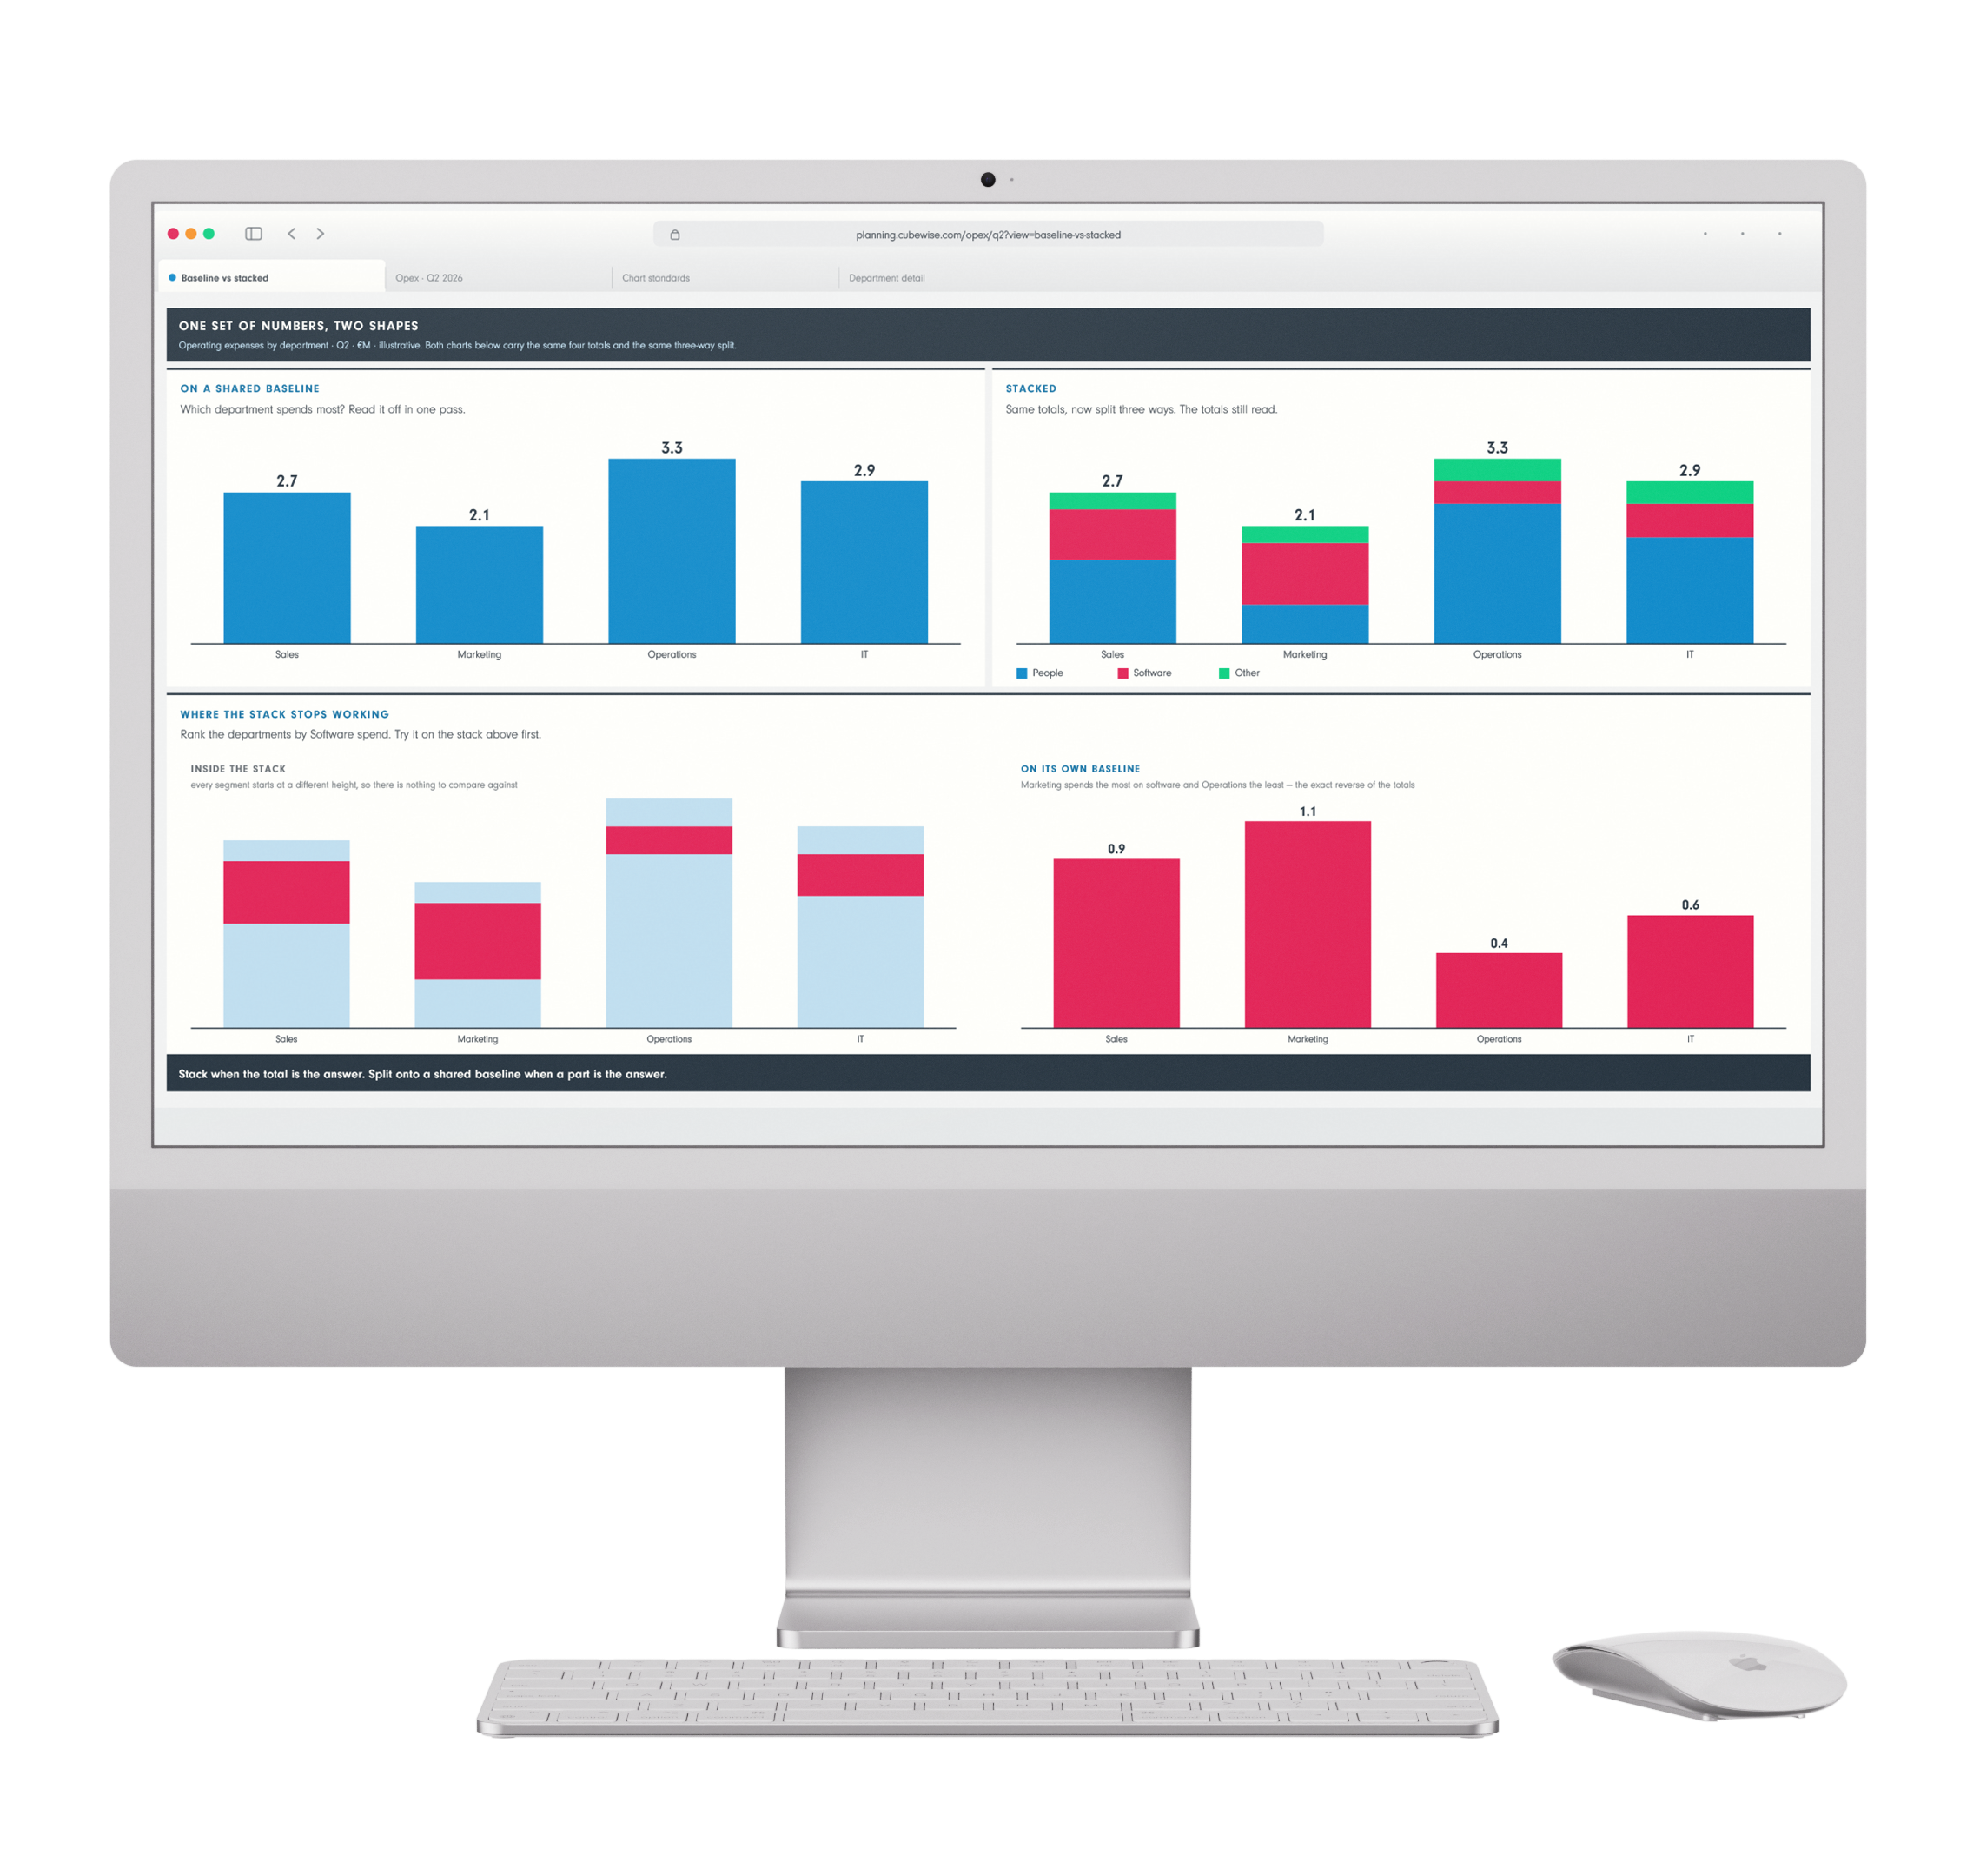
Headline.
Two lines.
One colour.
Supporting copy. Say what the reader gets and why it matters.
SERIES OR COLUMN NAME
by Author name
Notes:
CAROUSEL CARD 2 of 11 · 1080 x 1350 · LinkedIn portrait.
WHAT TO CHANGE — the copy only. Type into the boxes. Every box already carries the right face, weight, size and tracking; restyling them is how a carousel stops looking like the others in the set.
THE HEADLINE is Neuzeit Grotesk Black, one colour, never Sky Blue (§7.7a). The accent lives in the eyebrow, a rule, or a single stat instead.
ILLUSTRATIONS are placed as pictures and were left untouched by the templatiser. Swap one with right-click → Change Picture, or delete it and let the card breathe. Build new ones with the cubewise-illustration skill so they inherit the same palette and guards.
THE CUBEWISE LOGO is canonical (§8). Do not recolour, stretch or replace it. Card 1 and card N carry it; the middle cards do not (§11.2).
SOCIAL IS SKY BLUE (§11.0) whatever the subject. Max 10 cards. Card N carries a real call to action, not a sign-off.
BACKGROUNDS group in twos to fours before switching (§7.4a). A card-by-card alternation reads as a strobe, not a rhythm.

Slide 3
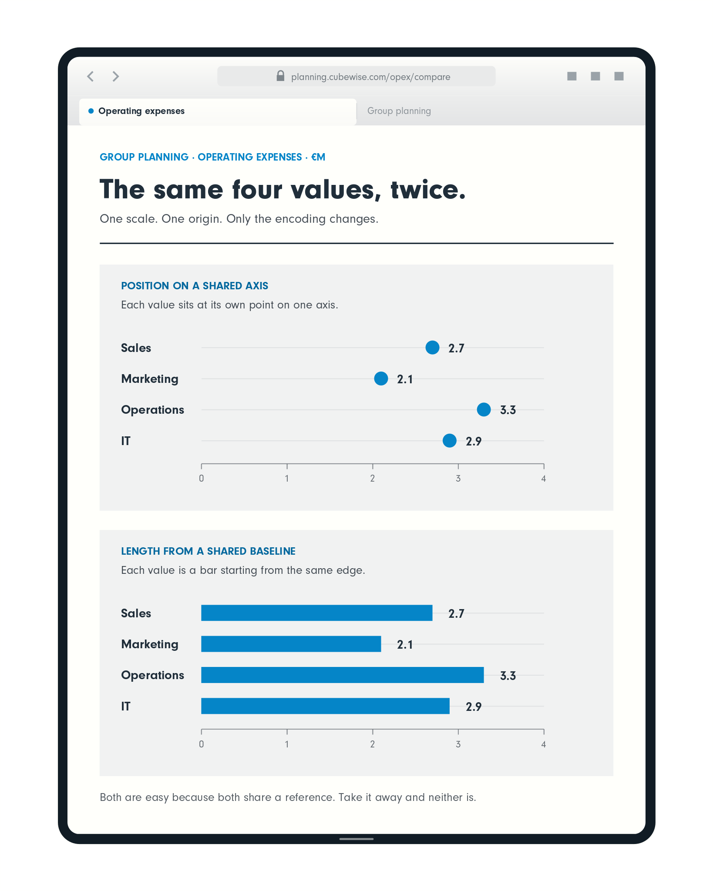
Headline.
Line.
Supporting copy. Say what the reader gets and why it matters.
Caption.
EYEBROW · ALL CAPS
Notes:
CAROUSEL CARD 3 of 11 · 1080 x 1350 · LinkedIn portrait.
WHAT TO CHANGE — the copy only. Type into the boxes. Every box already carries the right face, weight, size and tracking; restyling them is how a carousel stops looking like the others in the set.
THE HEADLINE is Neuzeit Grotesk Black, one colour, never Sky Blue (§7.7a). The accent lives in the eyebrow, a rule, or a single stat instead.
ILLUSTRATIONS are placed as pictures and were left untouched by the templatiser. Swap one with right-click → Change Picture, or delete it and let the card breathe. Build new ones with the cubewise-illustration skill so they inherit the same palette and guards.
THE CUBEWISE LOGO is canonical (§8). Do not recolour, stretch or replace it. Card 1 and card N carry it; the middle cards do not (§11.2).
SOCIAL IS SKY BLUE (§11.0) whatever the subject. Max 10 cards. Card N carries a real call to action, not a sign-off.
BACKGROUNDS group in twos to fours before switching (§7.4a). A card-by-card alternation reads as a strobe, not a rhythm.

Slide 4
EYEBROW · ALL CAPS
Headline goes here.
SERIES OR COLUMN NAME
by Author name
Notes:
CAROUSEL CARD 4 of 11 · 1080 x 1350 · LinkedIn portrait.
WHAT TO CHANGE — the copy only. Type into the boxes. Every box already carries the right face, weight, size and tracking; restyling them is how a carousel stops looking like the others in the set.
THE HEADLINE is Neuzeit Grotesk Black, one colour, never Sky Blue (§7.7a). The accent lives in the eyebrow, a rule, or a single stat instead.
ILLUSTRATIONS are placed as pictures and were left untouched by the templatiser. Swap one with right-click → Change Picture, or delete it and let the card breathe. Build new ones with the cubewise-illustration skill so they inherit the same palette and guards.
THE CUBEWISE LOGO is canonical (§8). Do not recolour, stretch or replace it. Card 1 and card N carry it; the middle cards do not (§11.2).
SOCIAL IS SKY BLUE (§11.0) whatever the subject. Max 10 cards. Card N carries a real call to action, not a sign-off.
BACKGROUNDS group in twos to fours before switching (§7.4a). A card-by-card alternation reads as a strobe, not a rhythm.

Slide 5
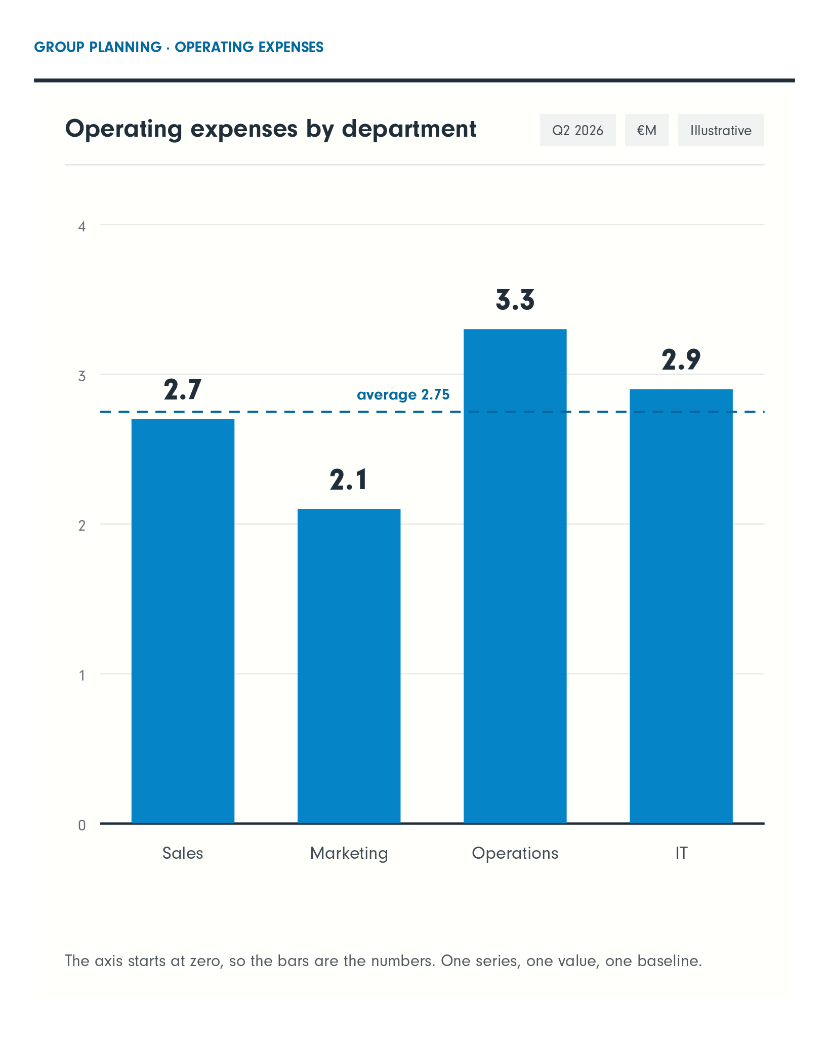
Headline here.
Supporting copy. Say what the reader gets and why it matters.
Two or three lines.
SERIES OR COLUMN NAME
by Author name
Notes:
CAROUSEL CARD 5 of 11 · 1080 x 1350 · LinkedIn portrait.
WHAT TO CHANGE — the copy only. Type into the boxes. Every box already carries the right face, weight, size and tracking; restyling them is how a carousel stops looking like the others in the set.
THE HEADLINE is Neuzeit Grotesk Black, one colour, never Sky Blue (§7.7a). The accent lives in the eyebrow, a rule, or a single stat instead.
ILLUSTRATIONS are placed as pictures and were left untouched by the templatiser. Swap one with right-click → Change Picture, or delete it and let the card breathe. Build new ones with the cubewise-illustration skill so they inherit the same palette and guards.
THE CUBEWISE LOGO is canonical (§8). Do not recolour, stretch or replace it. Card 1 and card N carry it; the middle cards do not (§11.2).
SOCIAL IS SKY BLUE (§11.0) whatever the subject. Max 10 cards. Card N carries a real call to action, not a sign-off.
BACKGROUNDS group in twos to fours before switching (§7.4a). A card-by-card alternation reads as a strobe, not a rhythm.

Slide 6
Headline here.
Two or three lines.
Supporting copy. Say what the reader gets and why it matters.
One colour, never Sky Blue.
SERIES OR COLUMN NAME
by Author name
Notes:
CAROUSEL CARD 6 of 11 · 1080 x 1350 · LinkedIn portrait.
WHAT TO CHANGE — the copy only. Type into the boxes. Every box already carries the right face, weight, size and tracking; restyling them is how a carousel stops looking like the others in the set.
THE HEADLINE is Neuzeit Grotesk Black, one colour, never Sky Blue (§7.7a). The accent lives in the eyebrow, a rule, or a single stat instead.
ILLUSTRATIONS are placed as pictures and were left untouched by the templatiser. Swap one with right-click → Change Picture, or delete it and let the card breathe. Build new ones with the cubewise-illustration skill so they inherit the same palette and guards.
THE CUBEWISE LOGO is canonical (§8). Do not recolour, stretch or replace it. Card 1 and card N carry it; the middle cards do not (§11.2).
SOCIAL IS SKY BLUE (§11.0) whatever the subject. Max 10 cards. Card N carries a real call to action, not a sign-off.
BACKGROUNDS group in twos to fours before switching (§7.4a). A card-by-card alternation reads as a strobe, not a rhythm.

Slide 7
Headline goes here.
Two lines.
The payoff line.
SERIES OR COLUMN NAME
by Author name
Notes:
CAROUSEL CARD 7 of 11 · 1080 x 1350 · LinkedIn portrait.
WHAT TO CHANGE — the copy only. Type into the boxes. Every box already carries the right face, weight, size and tracking; restyling them is how a carousel stops looking like the others in the set.
THE HEADLINE is Neuzeit Grotesk Black, one colour, never Sky Blue (§7.7a). The accent lives in the eyebrow, a rule, or a single stat instead.
ILLUSTRATIONS are placed as pictures and were left untouched by the templatiser. Swap one with right-click → Change Picture, or delete it and let the card breathe. Build new ones with the cubewise-illustration skill so they inherit the same palette and guards.
THE CUBEWISE LOGO is canonical (§8). Do not recolour, stretch or replace it. Card 1 and card N carry it; the middle cards do not (§11.2).
SOCIAL IS SKY BLUE (§11.0) whatever the subject. Max 10 cards. Card N carries a real call to action, not a sign-off.
BACKGROUNDS group in twos to fours before switching (§7.4a). A card-by-card alternation reads as a strobe, not a rhythm.

Slide 8
Headline goes here.
The payoff line.
Second payoff line.
SERIES OR COLUMN NAME
by Author name
Notes:
CAROUSEL CARD 8 of 11 · 1080 x 1350 · LinkedIn portrait.
WHAT TO CHANGE — the copy only. Type into the boxes. Every box already carries the right face, weight, size and tracking; restyling them is how a carousel stops looking like the others in the set.
THE HEADLINE is Neuzeit Grotesk Black, one colour, never Sky Blue (§7.7a). The accent lives in the eyebrow, a rule, or a single stat instead.
ILLUSTRATIONS are placed as pictures and were left untouched by the templatiser. Swap one with right-click → Change Picture, or delete it and let the card breathe. Build new ones with the cubewise-illustration skill so they inherit the same palette and guards.
THE CUBEWISE LOGO is canonical (§8). Do not recolour, stretch or replace it. Card 1 and card N carry it; the middle cards do not (§11.2).
SOCIAL IS SKY BLUE (§11.0) whatever the subject. Max 10 cards. Card N carries a real call to action, not a sign-off.
BACKGROUNDS group in twos to fours before switching (§7.4a). A card-by-card alternation reads as a strobe, not a rhythm.

Slide 9
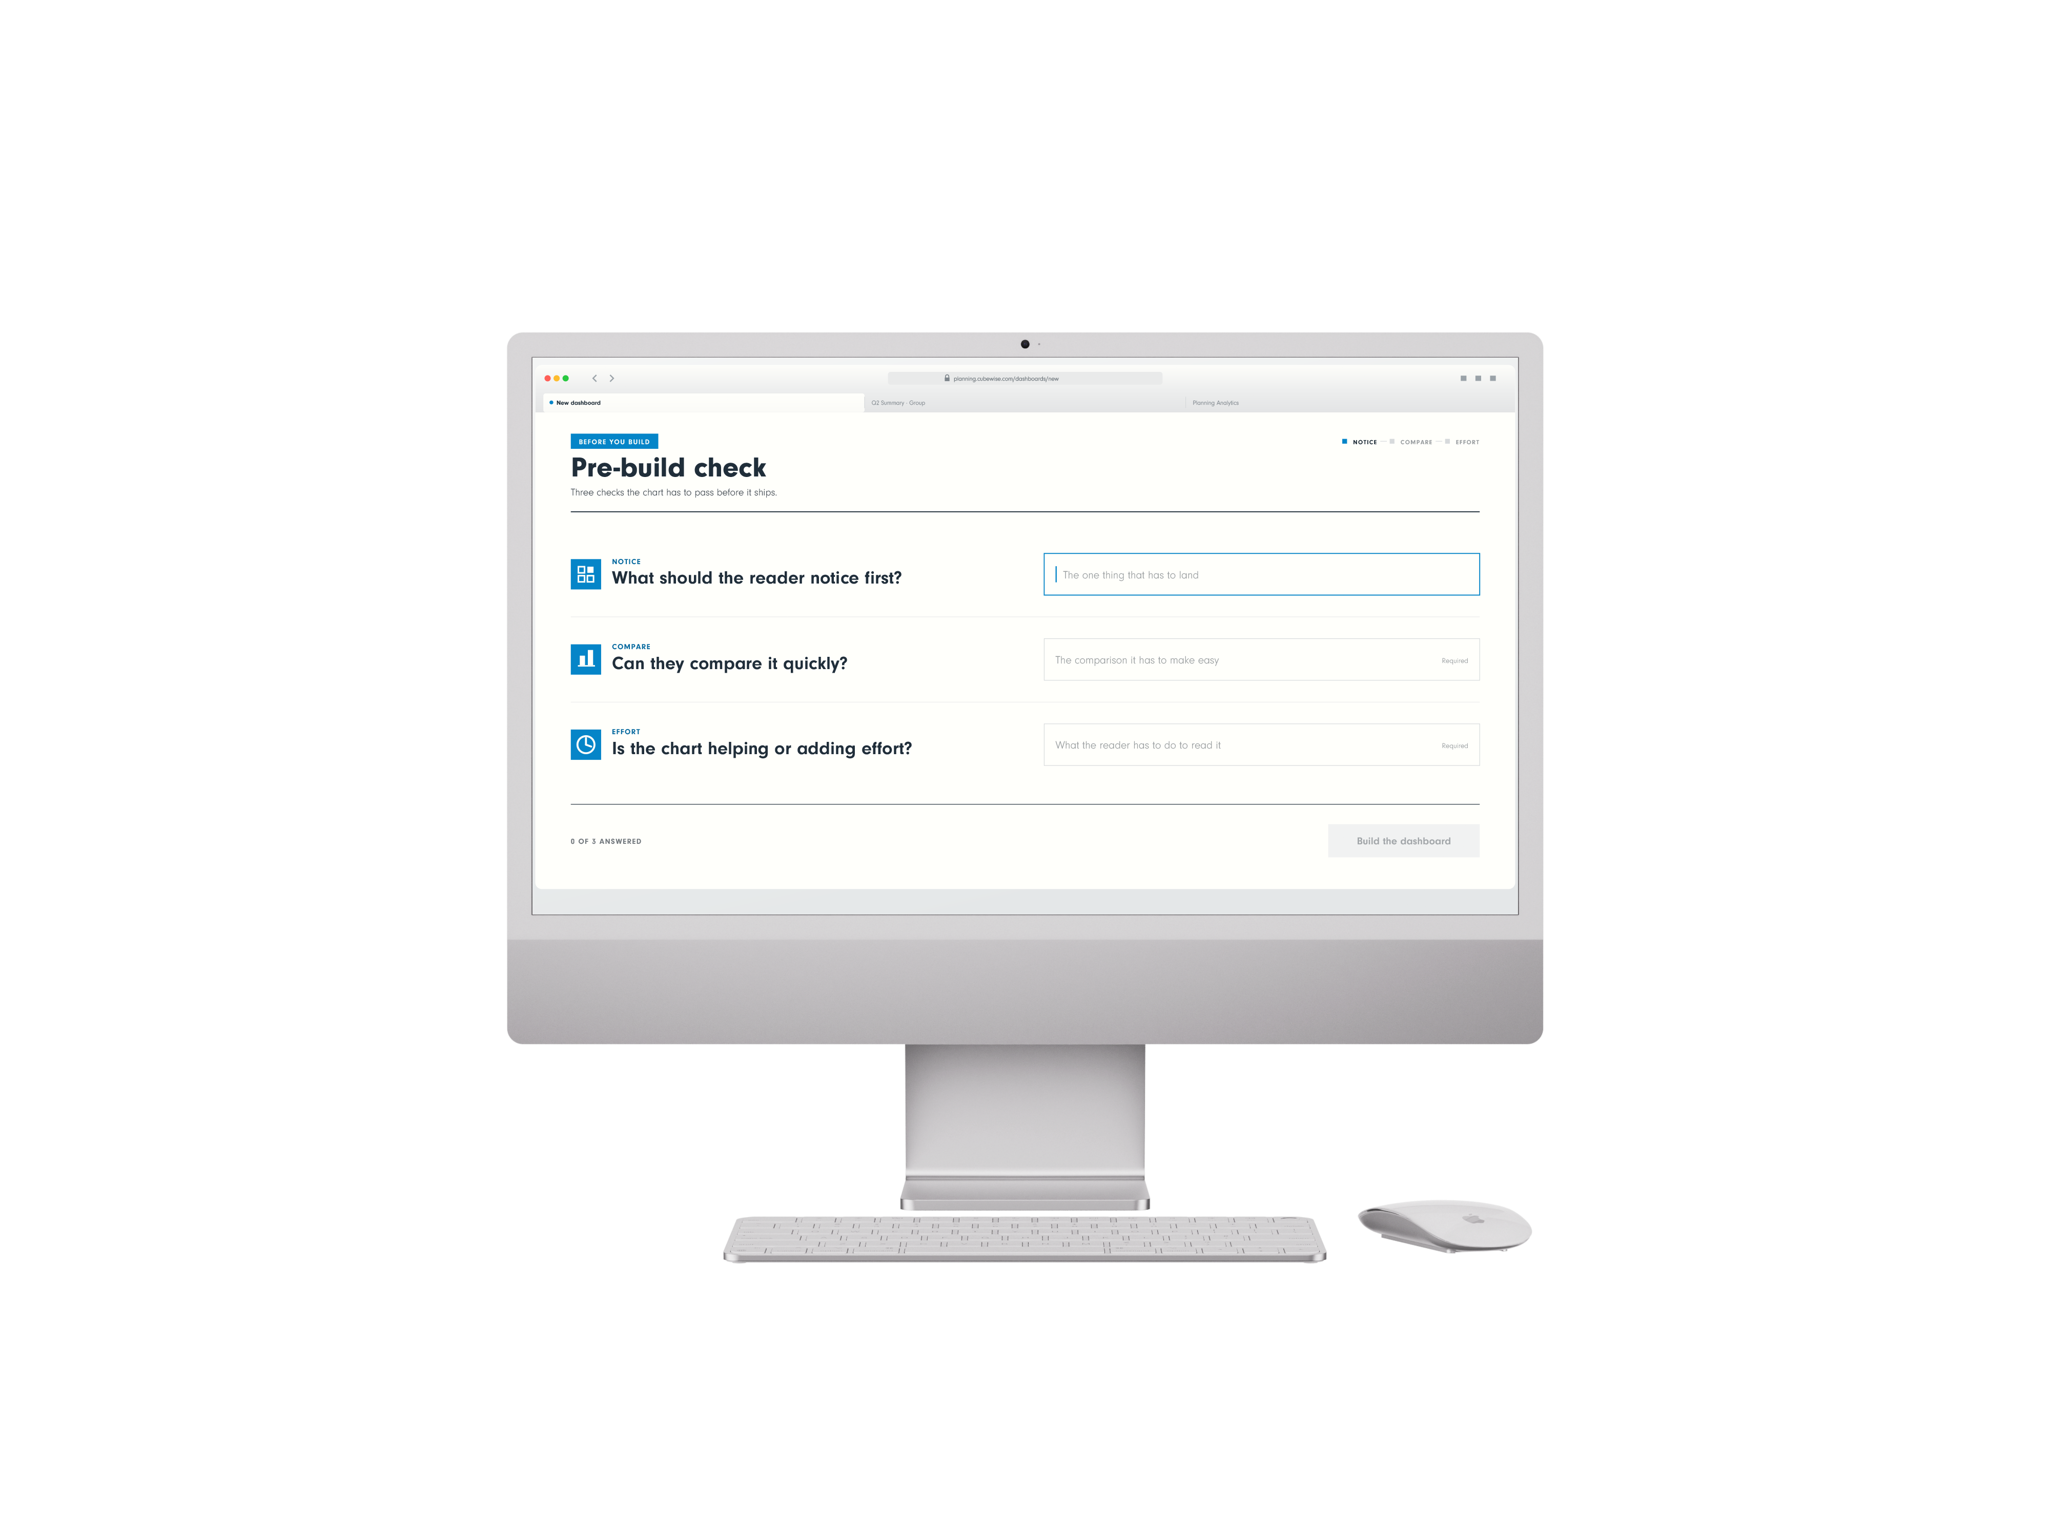
EYEBROW · ALL CAPS
Headline goes here.
Two lines.
One colour only.
SERIES OR COLUMN NAME
by Author name
Notes:
CAROUSEL CARD 9 of 11 · 1080 x 1350 · LinkedIn portrait.
WHAT TO CHANGE — the copy only. Type into the boxes. Every box already carries the right face, weight, size and tracking; restyling them is how a carousel stops looking like the others in the set.
THE HEADLINE is Neuzeit Grotesk Black, one colour, never Sky Blue (§7.7a). The accent lives in the eyebrow, a rule, or a single stat instead.
ILLUSTRATIONS are placed as pictures and were left untouched by the templatiser. Swap one with right-click → Change Picture, or delete it and let the card breathe. Build new ones with the cubewise-illustration skill so they inherit the same palette and guards.
THE CUBEWISE LOGO is canonical (§8). Do not recolour, stretch or replace it. Card 1 and card N carry it; the middle cards do not (§11.2).
SOCIAL IS SKY BLUE (§11.0) whatever the subject. Max 10 cards. Card N carries a real call to action, not a sign-off.
BACKGROUNDS group in twos to fours before switching (§7.4a). A card-by-card alternation reads as a strobe, not a rhythm.

Slide 10

SERIES OR COLUMN NAME
by Author name
Notes:
CAROUSEL CARD 10 of 11 · 1080 x 1350 · LinkedIn portrait.
WHAT TO CHANGE — the copy only. Type into the boxes. Every box already carries the right face, weight, size and tracking; restyling them is how a carousel stops looking like the others in the set.
THE HEADLINE is Neuzeit Grotesk Black, one colour, never Sky Blue (§7.7a). The accent lives in the eyebrow, a rule, or a single stat instead.
ILLUSTRATIONS are placed as pictures and were left untouched by the templatiser. Swap one with right-click → Change Picture, or delete it and let the card breathe. Build new ones with the cubewise-illustration skill so they inherit the same palette and guards.
THE CUBEWISE LOGO is canonical (§8). Do not recolour, stretch or replace it. Card 1 and card N carry it; the middle cards do not (§11.2).
SOCIAL IS SKY BLUE (§11.0) whatever the subject. Max 10 cards. Card N carries a real call to action, not a sign-off.
BACKGROUNDS group in twos to fours before switching (§7.4a). A card-by-card alternation reads as a strobe, not a rhythm.

Slide 11
Notes:
CAROUSEL CARD 11 of 11 · 1080 x 1350 · LinkedIn portrait.
WHAT TO CHANGE — the copy only. Type into the boxes. Every box already carries the right face, weight, size and tracking; restyling them is how a carousel stops looking like the others in the set.
THE HEADLINE is Neuzeit Grotesk Black, one colour, never Sky Blue (§7.7a). The accent lives in the eyebrow, a rule, or a single stat instead.
ILLUSTRATIONS are placed as pictures and were left untouched by the templatiser. Swap one with right-click → Change Picture, or delete it and let the card breathe. Build new ones with the cubewise-illustration skill so they inherit the same palette and guards.
THE CUBEWISE LOGO is canonical (§8). Do not recolour, stretch or replace it. Card 1 and card N carry it; the middle cards do not (§11.2).
SOCIAL IS SKY BLUE (§11.0) whatever the subject. Max 10 cards. Card N carries a real call to action, not a sign-off.
BACKGROUNDS group in twos to fours before switching (§7.4a). A card-by-card alternation reads as a strobe, not a rhythm.

